Slide 1
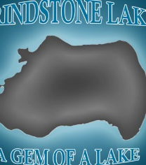
Aquatic Invasive Species
Scott Van Egeren, WI DNR and Pat Brown, Sawyer County
Grindstone Lake Association Planning and Protection Workshop
July 27, 2019

Slide 2
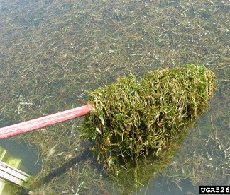
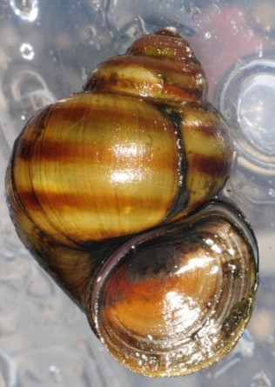
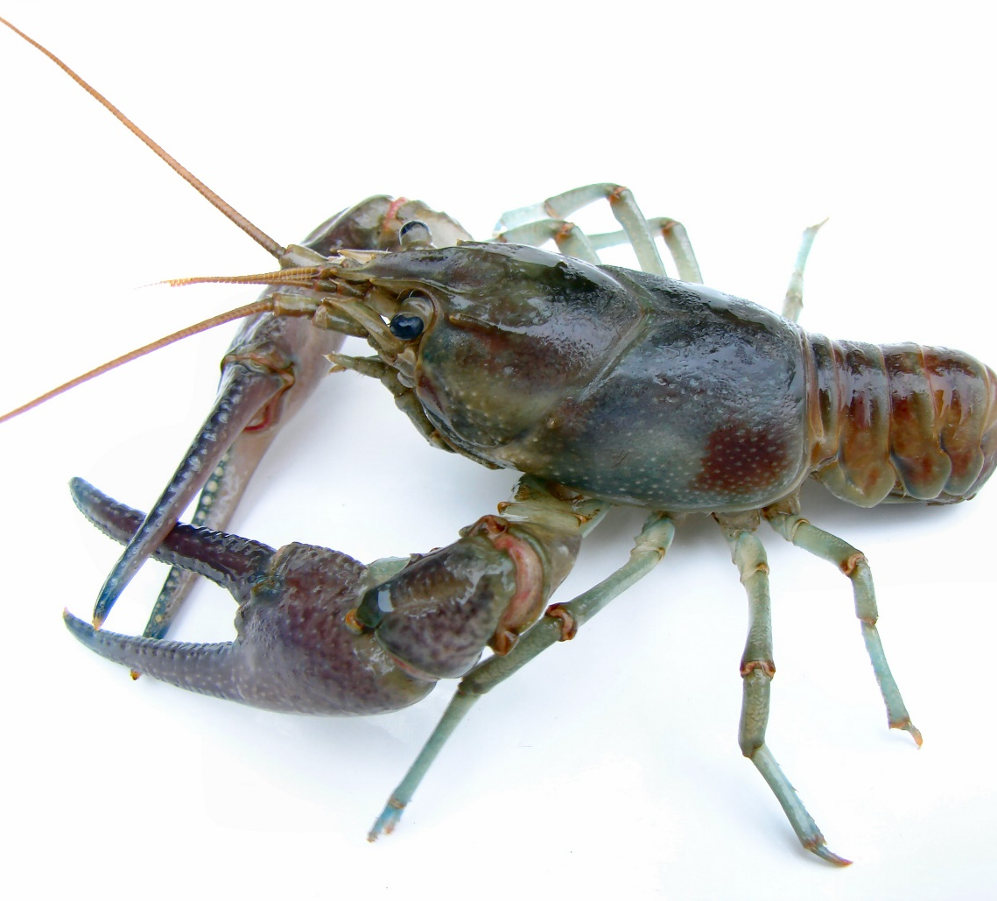
Aquatic Invasive Species (AIS) in Grindstone Lake
Banded Mystery Snails
Curly Leaf Pondweed (CLP)
Rusty Crayfish
https://dnr.wi.gov/lakes/invasives/AISByWaterbody.aspx?location=58

Slide 3
Banded Mystery Snail
Native to the southeastern US
Primarily spread by recreational boaters
Operculum seals so snails survive at least 4 weeks of air exposure—easy to transport and spread
Impacts unknown
https://www.jakevzlab.net/chinese-mystery-snail.html

Slide 4
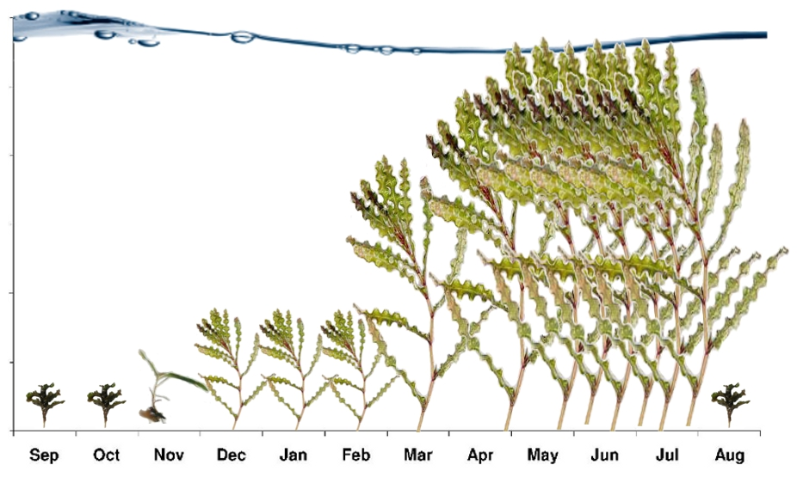
Curly-leaf pondweed (Potamogeton crispus)
Native to Eurasia
Accidentally introduced to Wisconsin in 1905 along with fish imported from Europe
Outcompetes native underwater plants and becomes dominant
Grows under the ice while most plants are dormant, dies back in mid-July
Mid-summer die-off can cause dense mats of dying vegetation, low DO, and releases of nutrients such as phosphorus which can fuel algal blooms.

Slide 5
Rusty Crayfish (Orconectes rusticus)
(rust colored)
(rust colored)
Native to Ohio River Basin
Used as live bait prior to being banned in 1983
Bait bucket release was a major vector of introductions
https://www.jakevzlab.net/rusty-crayfish.html

Slide 6
Rusty Crayfish (Orconectes rusticus
Displace native crayfishes
Voracious omnivores that feed opportunistically on aquatic plants, detritus, invertebrates, and fish eggs
Can reduce submergent vegetation, snails and some fish species (i.e. sunfish)

Slide 7
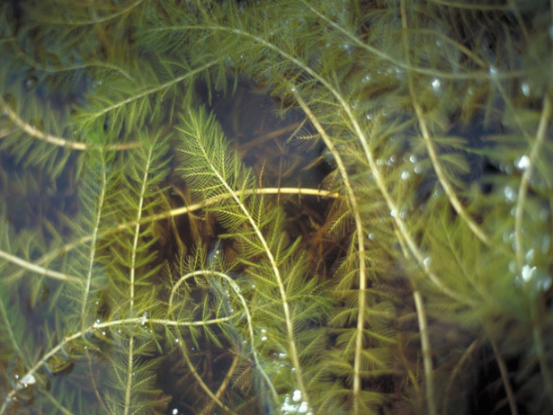
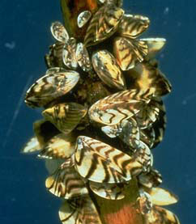
Additional threats
Eurasian Milfoil: Identified in Lac Courte Oreilles in 2015
Zebra mussels- Big McKenzie (Burnett/Washburn counties)
NZ Mud snails and Starry Stonewort
(Southern Wisconsin and Minnesota)

Slide 8
Role of Sawyer County Zoning and Conservation
AIS training and education
  Lake Association Volunteers- help is needed here! (GLA only has two)
    Clean Boats Clean Waters Boat Inspectors
  Brochures and informational materials
No funding
  Sawyer Co AIS team are currently working solely under a DNR grant
Additional activities
  Shoreline protection information
  Management of Billy Boy
Notes:
Brochures and other information- I have many different DNR approved handouts. These range from quick ID cards to information/educational materials.
Additionally, I normally have materials for lakes to participate in the annual statewide CBCW campaigns (Drain Campaign and Landing Blitz)
Other AIS related services- Species ID, some lake monitoring, some limited AIS mapping, and training events.
Shoreline protection- The best thing you can do is stop mowing and work to restore the shoreland buffer area with native deep rooted vegetation. Ice heaving and summer storm damage is becoming a problem however and under certain scenarios bank reinforcement many be necessary ( DNR permitting required)
Billy Boy Dam- Owned by Sawyer County and operated by Zoning and Conservation staff within the parameters of the PSC order of 1955

