Slide 1
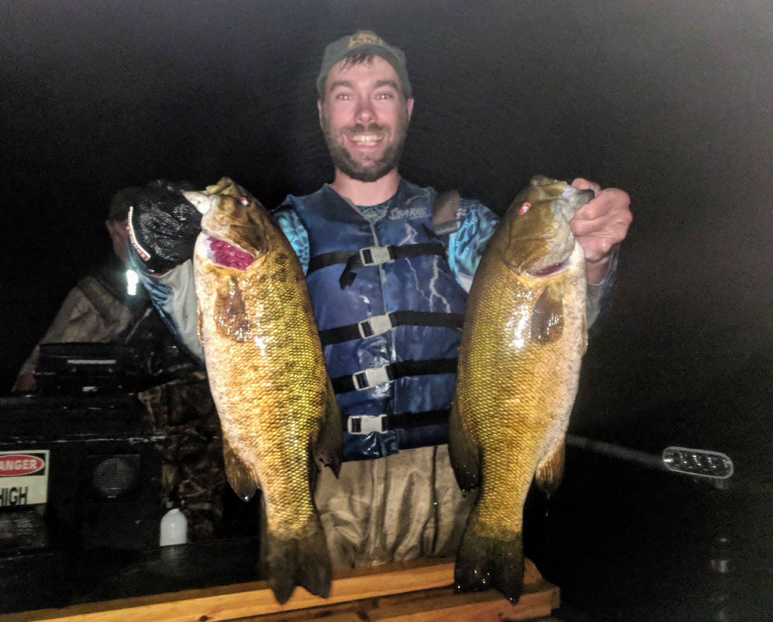
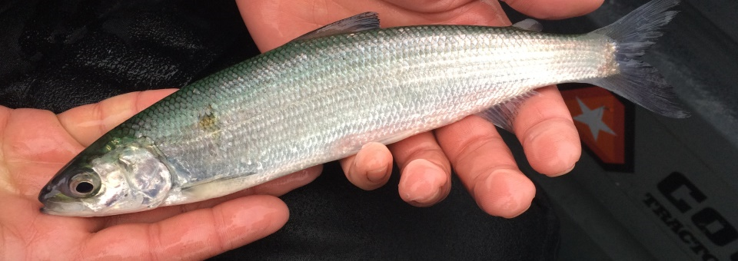
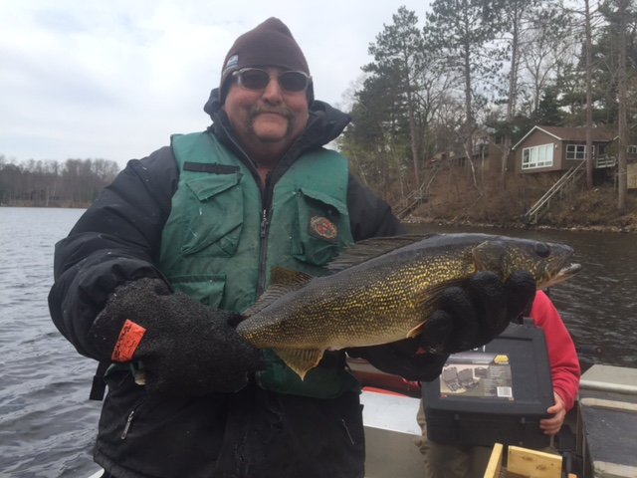
Trends, Threats, and Opportunities for Important Fish Species in Grindstone Lake
Max Wolter – WDNR Fisheries Biologist

Slide 2
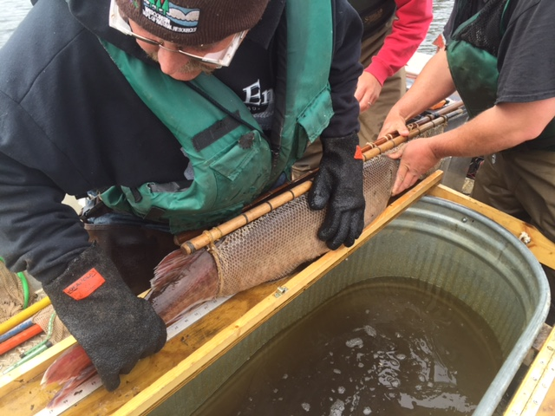
Outline
Walleye
Muskellunge
Smallmouth bass
Cisco

Slide 3
Species | Relative Angler Effort (% of all angling effort) | Average Number of Hours to Catch a Targeted Fish | Estimated Total Angler Catch* | Estimated Total Angler Harvest*
Walleye | 34.2 | 3.5 | 3,075 | 667
Yellow perch | 8.8 | 0.5 | 14,561 | 2,683
Black crappie | 1.8 | 17.8 | 37 | 37
Muskellunge | 7.5 | 125 | 39 | 0
Smallmouth | 32.3 | 0.9 | 11,772 | 61
Bluegill | 8.2 | 0.6 | 13,819 | 4,159
Trout** | No current fishery** | ** | ** | **
N. pike | 1.9 | 18.3 | 248 | 79
Rock bass | 2.4 | 0.8 | 2,623 | 253
Largemouth | 2.3 | 5.2 | 402 | 10

Slide 5
Target Abundance

Slide 6
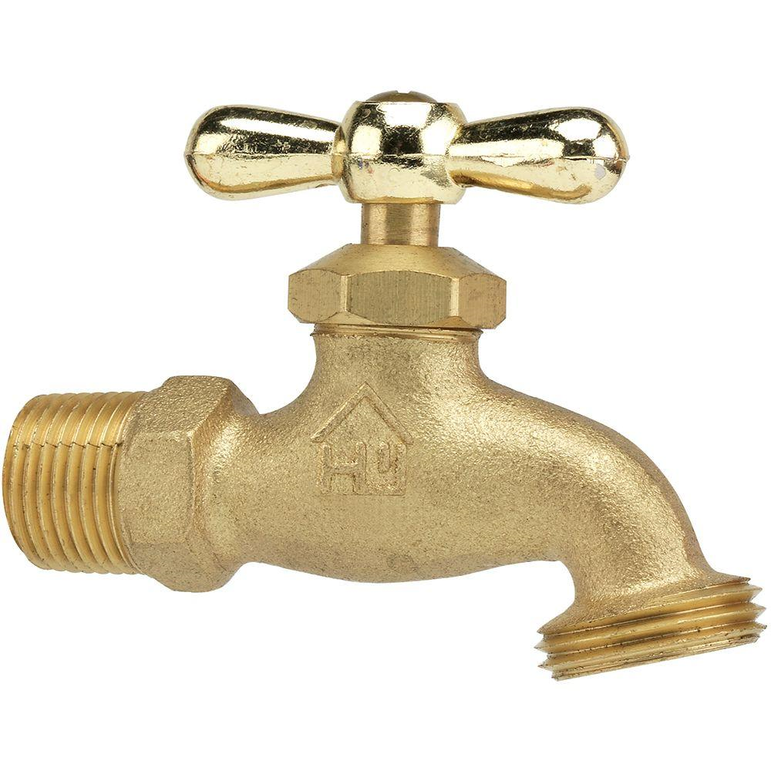
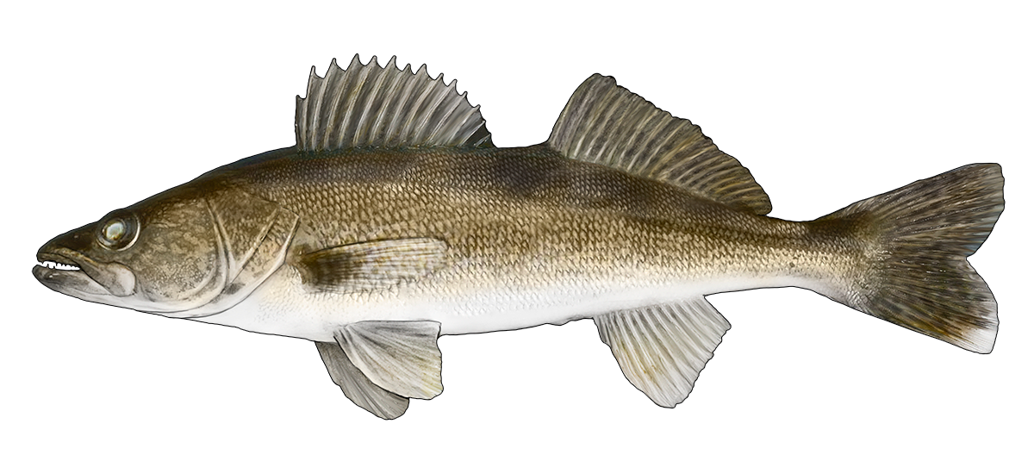
Recruitment
Natural Mortality
Fishing Mortality

Slide 7
Recruitment
Natural Mortality
Fishing Mortality

Slide 8
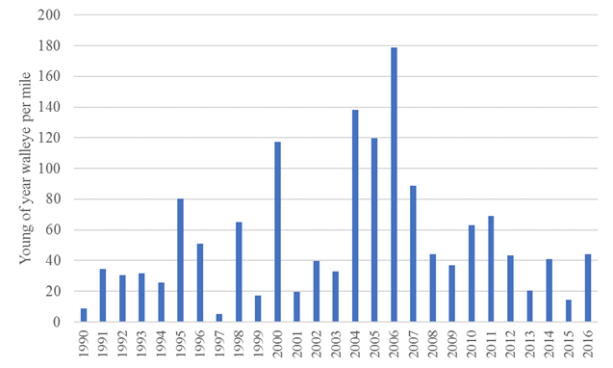

Slide 9
Walleye Summary
Still strong recruitment (top 5 in Sawyer County)
Adult density likely to remain stable, but not likely to increase.
Public prefers harvest oriented management
Climate change greatest threat to walleye recruitment in the future (see LCO, Nelson, Sissabagama, Osprey, Blueberry, Chetac, Windfall, etc…)

Slide 11
Target Abundance

Slide 12
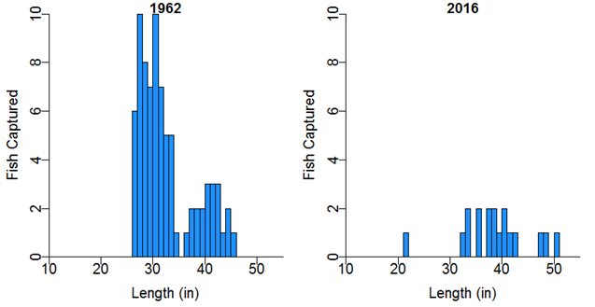

Slide 13
Muskellunge Summary
Muskellunge abundance has been declining, currently much lower than target levels.
Angler harvest has been reduced to effectively zero, some tribal harvest still exists
Natural reproduction is minimal, and not enough to reverse trends. Stocking does not appear to be consistently successful.

Slide 14
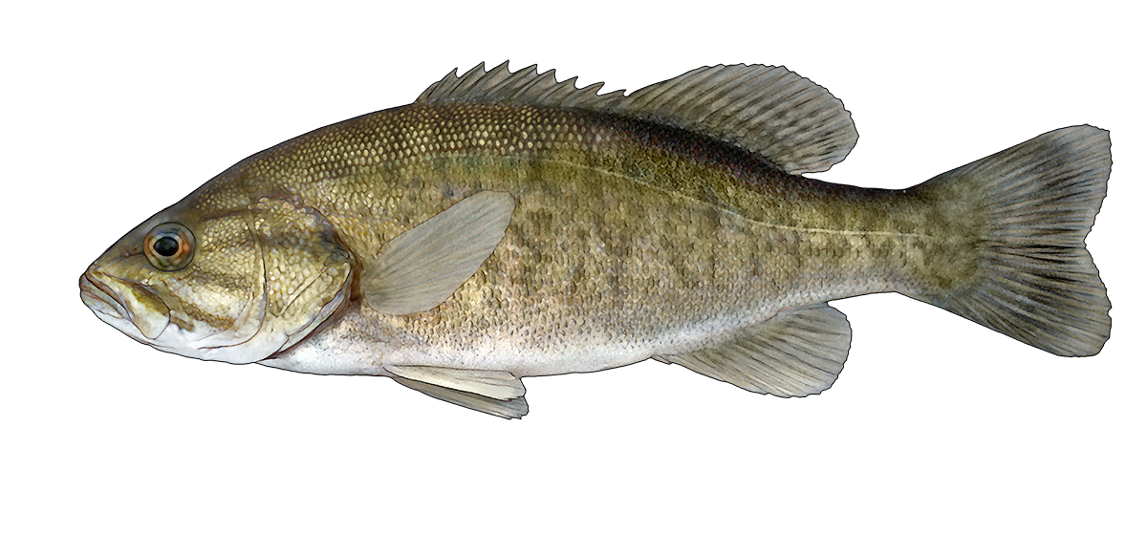

Slide 15
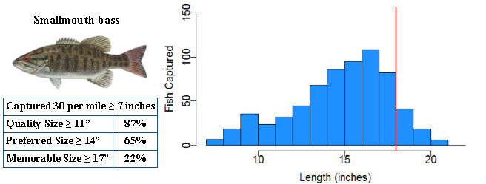

Slide 16
Smallmouth Summary
Regulations recently changed to promote more catch and release, increase in size.
Bass tournament issue is complicated.
Smallmouth coexist well with walleye and musky.
Habitat improvements could be beneficial.

Slide 17
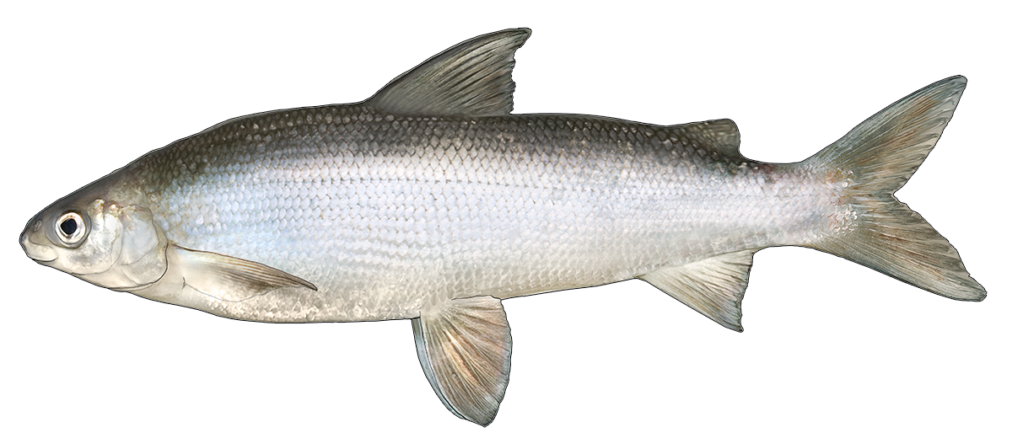

Slide 18
Lake surface
Warm water
High oxygen
Water column
Lake bottom
Cold water
Low oxygen

Slide 19
Lake surface
Warm water
High oxygen
Water column
Lake bottom
Cold water
Low oxygen

Slide 20
Cisco Summary
Grindstone has maintained a fairly strong cisco population
Important food item for gamefish (walleye, pike, muskellunge)
Climate change (temperature increase) and increased productivity (oxygen depletion) major threats to cisco.

