Slide 1

Grindstone Lake Association
2022 Annual Meeting
July 9, 2022

Slide 2
Agenda
Welcome and Updates – Donna Carlson
Financial – Mike Warden
Clean Water, Clean Boats – Rich Post, Mike Warden
Christy Dundee, CBCW
Lake Management Plan – Donna Carlson
Lake Survey – Karen Mumford
Shoreline Restoration – Sean Humphreys
Grindstone Lake Association Governance – Donna Carlson
Announcements – Donna Carlson

Slide 3
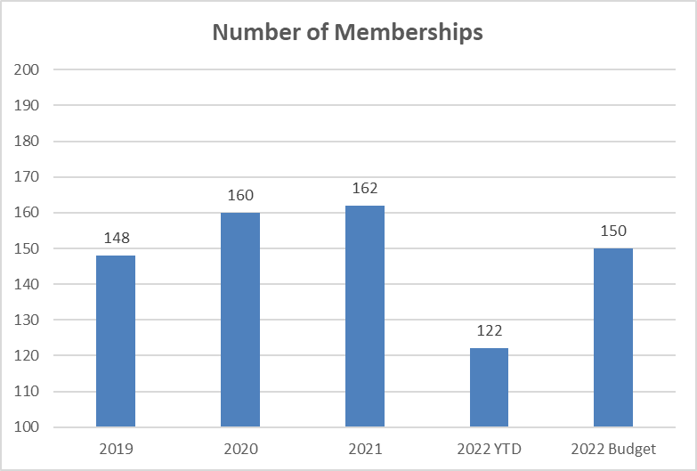
Financial Report – Memberships

Slide 4
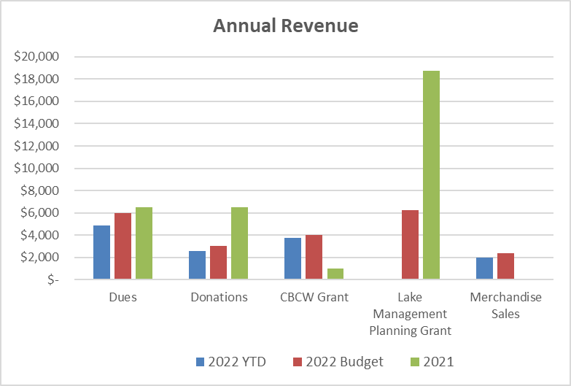
Financial Report – Revenue

Slide 5
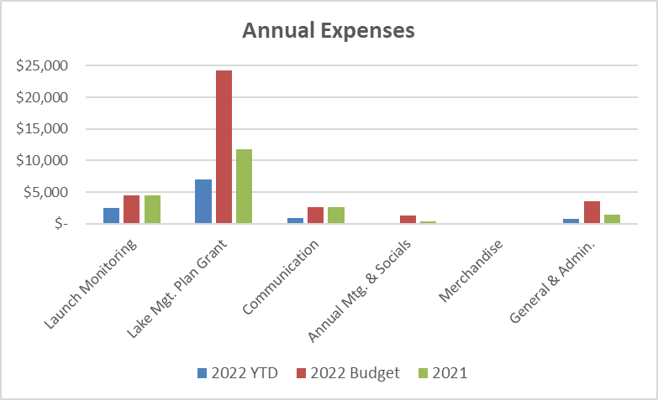
Financial Report – Expenses

Slide 6
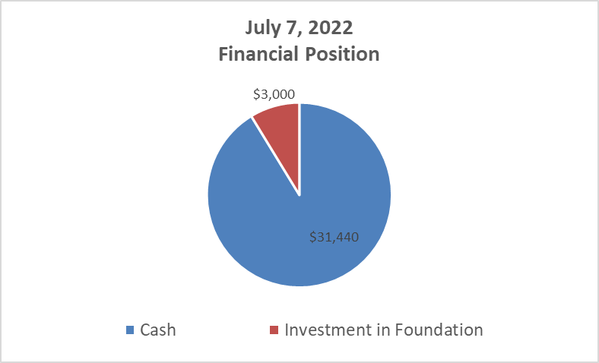
Financial Report – Financial Position

Slide 7
Financial Report – Lake Management Planning Grant Two Year Budget

Slide 8

Clean Boats, Clean Water
CBCW monitoring is subsidized by a grant from the WI DNR
Inspectors are trained to inspect boats and educate boaters on invasive species at public landings statewide
1,014 boats were inspected on Grindstone Lake in 2021!
2,160 people were educated on AIS on Grindstone Lake in 2021!
Grant much be matched by a minimum # of volunteer hours (contact Rich Post for volunteer information: richpost1@outlook.com)

Slide 9
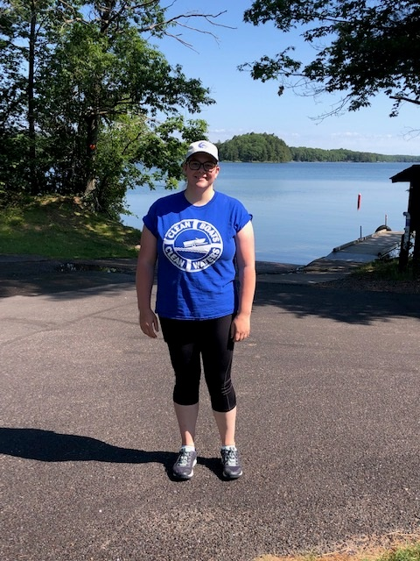
Clean Boats, Clean Water
Meet Christy Dundee, Grindstone’s 2022 CBCW Monitor!
Graduated from UW Whitewater
(Biology Major & Environmental Studies Minor)
Moving to greater Hayward area this summer
Stationed at the main public landing off Hwy K
Monitoring hours are 7:00am – 12:00 pm (Th-Sun + Holidays)

Slide 10
Comprehensive Lake Management Plan
GLA Annual Meeting
July 9, 2022

Slide 11
Comprehensive Lake Management Plan
Defined and described by WI DNR (Surface Water Grant Program, 2020)
GLA received $25,000 grant in April 2021
  Covers maximum of 67% of grant costs (rest covered by GLA)
  Contracted with Ecological Integrity Services (Steve Schieffer) for monitoring data
  Resident survey by UW – Eau Claire Professor Karen Mumford
  Lake Management Plan – Harmony Environmental (Cheryl Clemens)

Slide 12
Comprehensive Lake Management Plan
Collecting information
  Physical data (hydrology, surface area, watershed)
  Baseline chemistry (secchi depth, temperature, dissolved oxygen, pH, total phosphorus, chlorophyll-a)
  Land Use (watershed and shoreland)
  Aquatic plants (point intercept survey)
  Aquatic invasive species
  Riparian land ownership and resident survey
  Lake shoreland habitat assessment
  Related management plans
  Modeling
  Fisheries data
  Public information (boat launches, beaches, previous grants)

Slide 13
Comprehensive Lake Management Plan
Lake
  Grindstone Lake
  Tributaries
  Shoreline and shoreland
  Watershed
  Community of shoreline residents and visitors

Slide 14
Comprehensive Lake Management Plan
10-Year Planning and Implementation Document
  Identifies threats, problems, causes
  Incorporates community and its goals
  Develops an implementation schedule
  Dynamic and updated regularly
Why?
  Deeper, richer understanding of our lake and its challenges and threats
  Access to Lake Management Implementation funds from DNR

Slide 15
Comprehensive Lake Management Plan

Slide 16
Grindstone Lake Resident Survey
GLA Annual Meeting
July 9, 2022

Slide 17
Survey Purpose
Help lake residents contribute to the development of the Comprehensive Lake Management Plan
Further our understanding of the Grindstone Lake community
Identify ways to involve residents in lake protection activities and the Grindstone Lake Association.

Slide 18
Survey distribution and response
Online Survey Link and Instructions sent to:
  243 residents in which we had email addresses
  131 post cards to residential addresses (no email addresses)
  Total of 374 contacts
189 completed surveys: 51% response rate

Slide 19
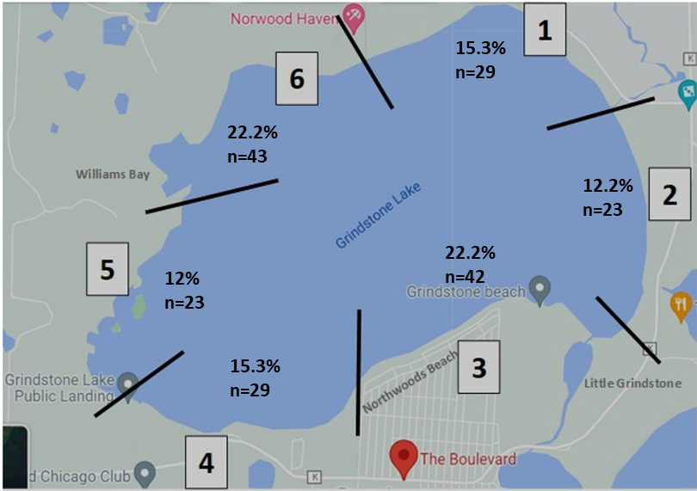
Survey distribution and response
Reasonable response levels from each lake zone

Slide 20
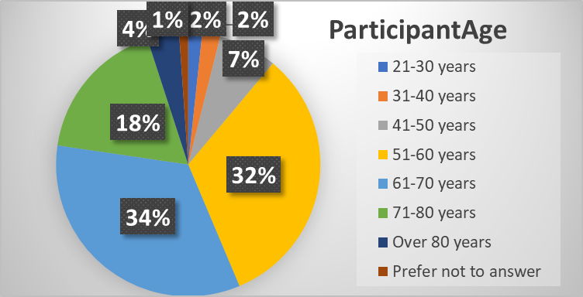
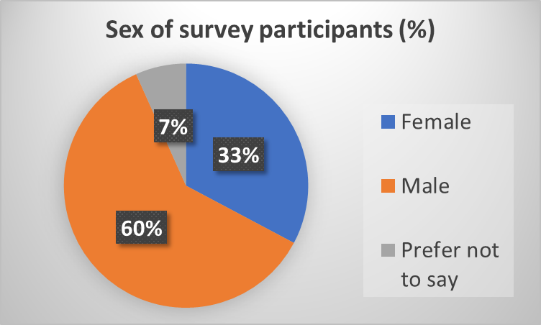
Survey distribution and response
Highest percent of survey participants in the
two age groups
  51-60 year of age
  61-70 age groups
60% males

Slide 21
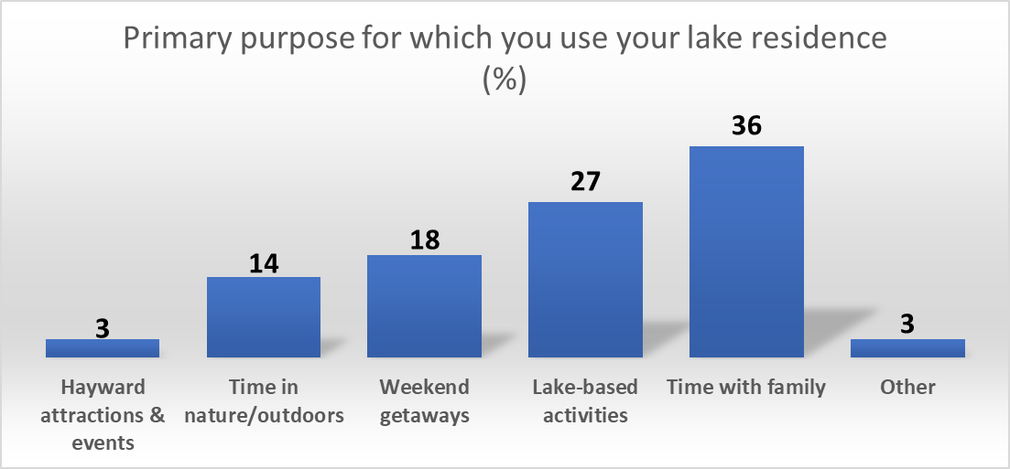
Primary Use of Lake Residence (%)

Slide 22
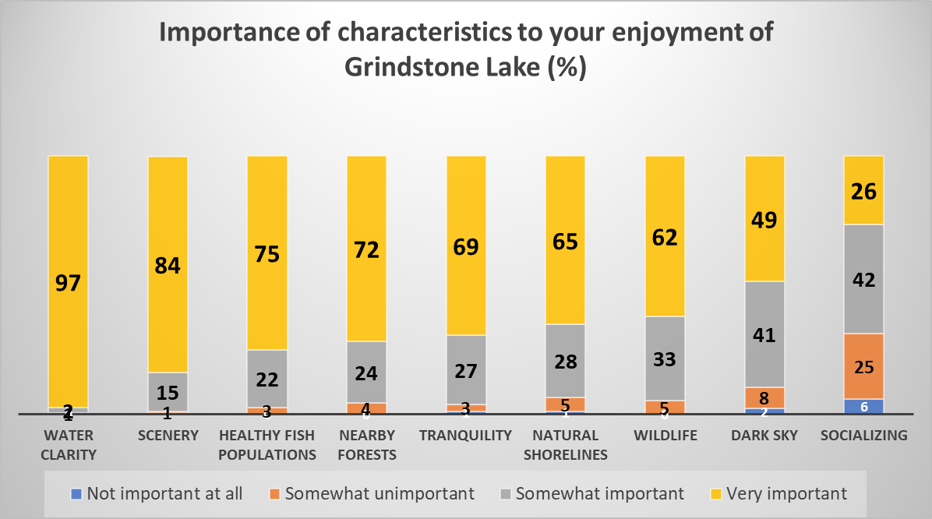

Slide 23
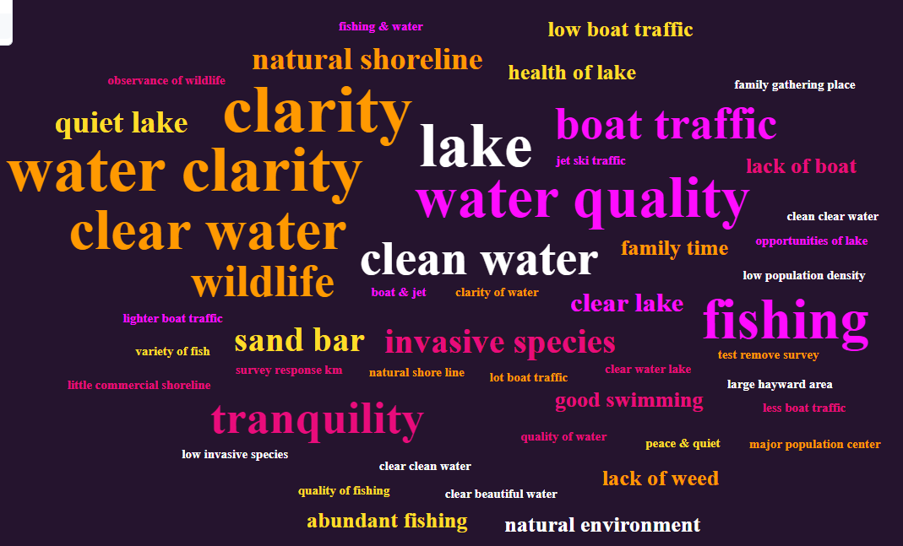
What do you value about Grindstone Lake?

Slide 24
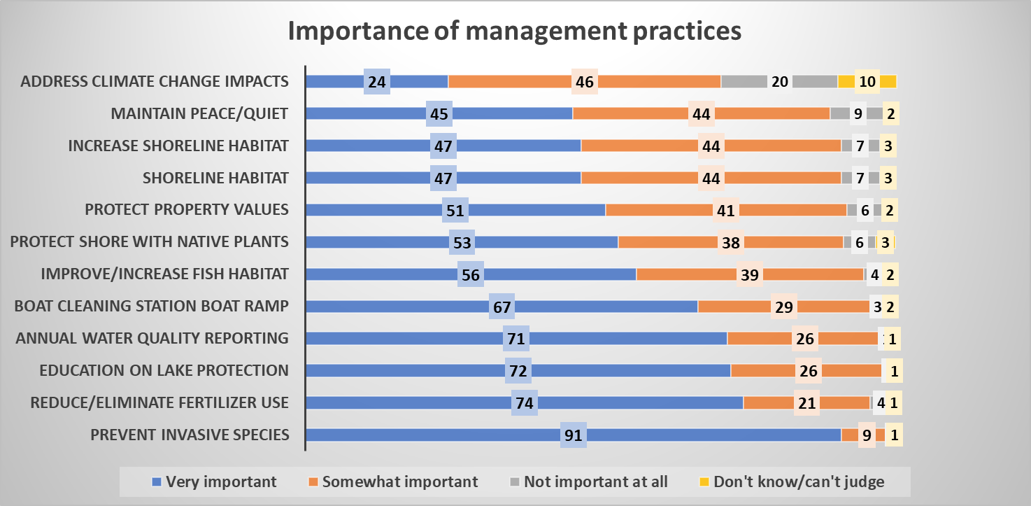

Slide 25
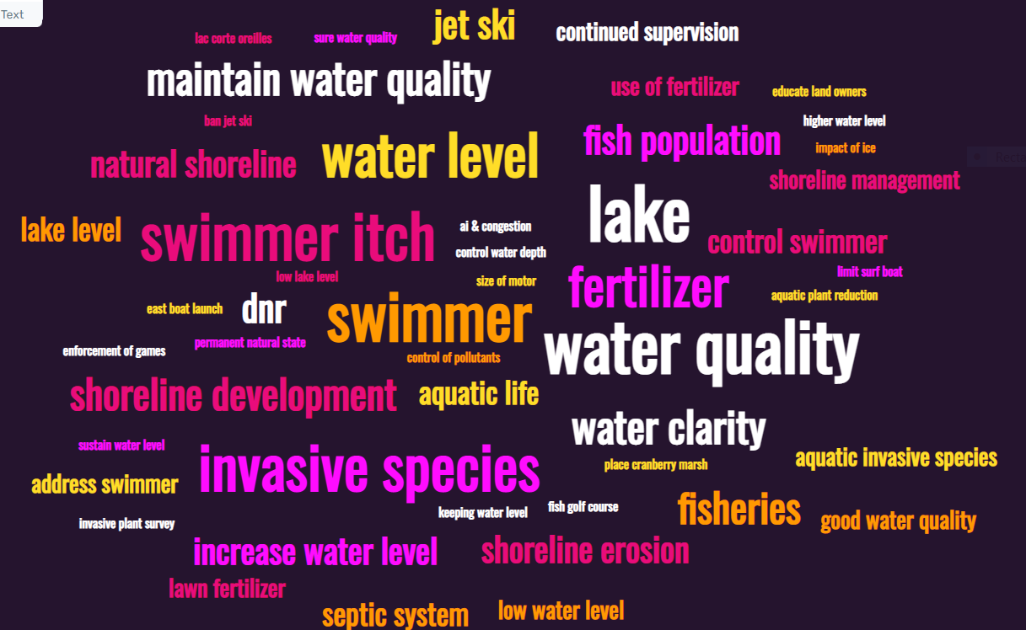
What is needed to protect Grindstone Lake?

Slide 26
Next Steps
Integrate resident survey information into draft management plan
Place draft plan on GLA website for review and input
Develop plans to involve residents in lake protection activities and the Grindstone Lake Association

Slide 27
Shoreline Restoration
GLA Annual Meeting
July 9, 2022

Slide 28
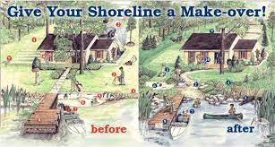
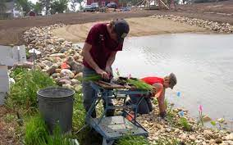
Shoreline Restoration
Why shoreline restoration?
  Stop erosion
  Stop runoff of pollutants entering lake
  Shoreline Esthetics & improved property values
  Improve/restore natural biological cycle of the lake
  Improve water quality and habitat for fish, plants, loons, eagles,
  otters, and all the other creatures that call our lake home.
Who Can Do It?
  Any landowner can use the shoreline evaluation tool and then can apply for up to $1000 per project (you can even propose multiple projects on your property).
  Then, you can:
      Do it yourself
      Hire shoreline landscaping experts
      MAYBE get your kids to help…..

Slide 29
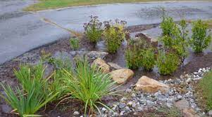
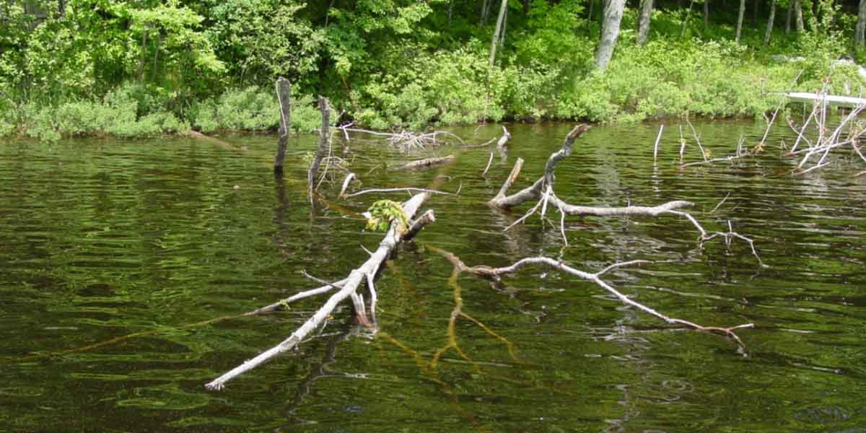
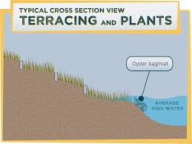
Shoreline Restoration
  What Can You Do?
  Natural non invasive plants and flowers
  Planting trees along shoreline
  Shoreline stabilization features (rocks or terraced gardens)
  Fish stix to waters edge (cut whole or large parts of trees tied to shore)
  Rain gardens
  Rain barrels to downspouts
Where Can I Do It?
Goal is to stop runoff and preserve native shorelines
    Typically focus on the first 30 feet of shoreline from the waters edge.
    grant funding native planting covers a 350 sq ft area

Slide 30
Shoreline Restoration
When and How do I Get Started?
Wisconsin Shoreline Evaluation Tool
  Use the web-based interactive tool to evaluate your shoreline’s health
  Answer simple responsive questions, anonymously or register
  Learn strategies to improve your shoreline
  Get tailored suggestions and your shoreline score
  survey.healthylakeswi.com
  Grant funding applications
  All Healthy Lakes & Rivers applications are due November 1 each year, and funding is determined by March. First-time applicants are required to complete a pre-application due September 2.
  Grant applications must be submitted through Grindstone Lake Association
  healthylakeswi.com
Grindstone Lake Association
Sean Humphreys 651-260-5906
shumphreys625@gmail.com%20

Slide 31
Board of Directors (for Review and Approval for 2021-2022)
Officers
Donna Carlson – President
Michael (Mike) Warden – Treasurer
Cynthia (Cindy) Parker – Secretary
Board Members
Cheryl Contant – Membership
David Kieffer – Communications
Rich Post – Clean Boats, Clean Water
Sean Humphreys – Invasive Species, Shoreline Restoration
Karen Mumford – Lake Management Plan
TBD - Web & Social Media Management
TBD – Annual Meeting, Outreach & Social Activities

Slide 32
Opportunities for Involvement
GRINDSTONE LAKE NEEDS YOUR SUPPORT!
Boat Landing Monitoring – Highway K
Dates: 7/16-17/2022
Two shifts each day – 7-9:30 am, 9:30-12 am
          https://www.signupgenius.com/go/904094faeab28a7f58-glavolunteer1
Shoreline Restoration
AIS monitoring and removal
Grant Submission
Marketing and Social Activities
Digital Media
Website management
Sign up and get involved!
grindstonelake.org
Sign up sheets

Slide 33
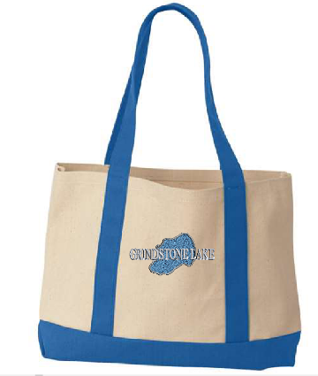
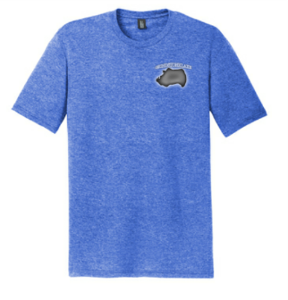
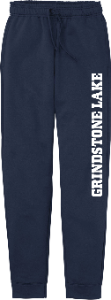
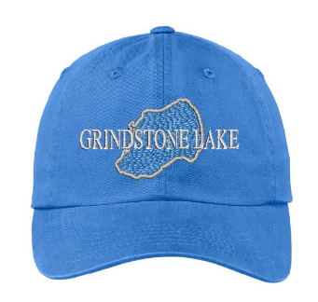
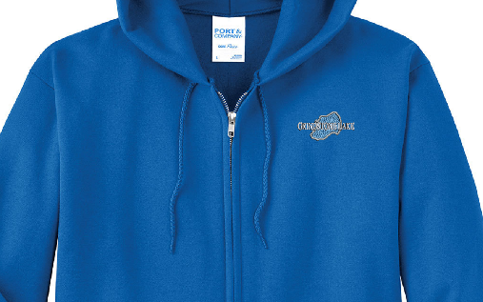
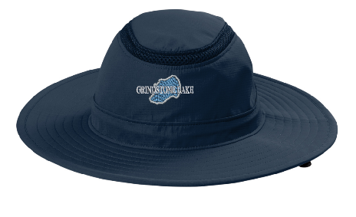
Reminder – Saturday, July 9, 2022
Order at: https://stores.inksoft.com/grindstonelake OR
https://grindstonelake.org/grindstone-lake-logo-wear
Cranberry Bog Tours: 11:00 AM; 1:00 PM
Meet at Bog - 14904 W County Hwy K
Grindstone Lake Social: 3-5:00 PM
The Boulevard – Cash Bar, Snacks
Grindstone Lake Gear: July 1 – 20, 2022
Order at: https://stores.inksoft.com/grindstonelake OR
https://grindstonelake.org/grindstone-lake-logo-wear

Slide 34
THANK YOU!!!
Newsletter Design and Production
Dee Hobbie
New and Renewing GLA members

