Slide 1
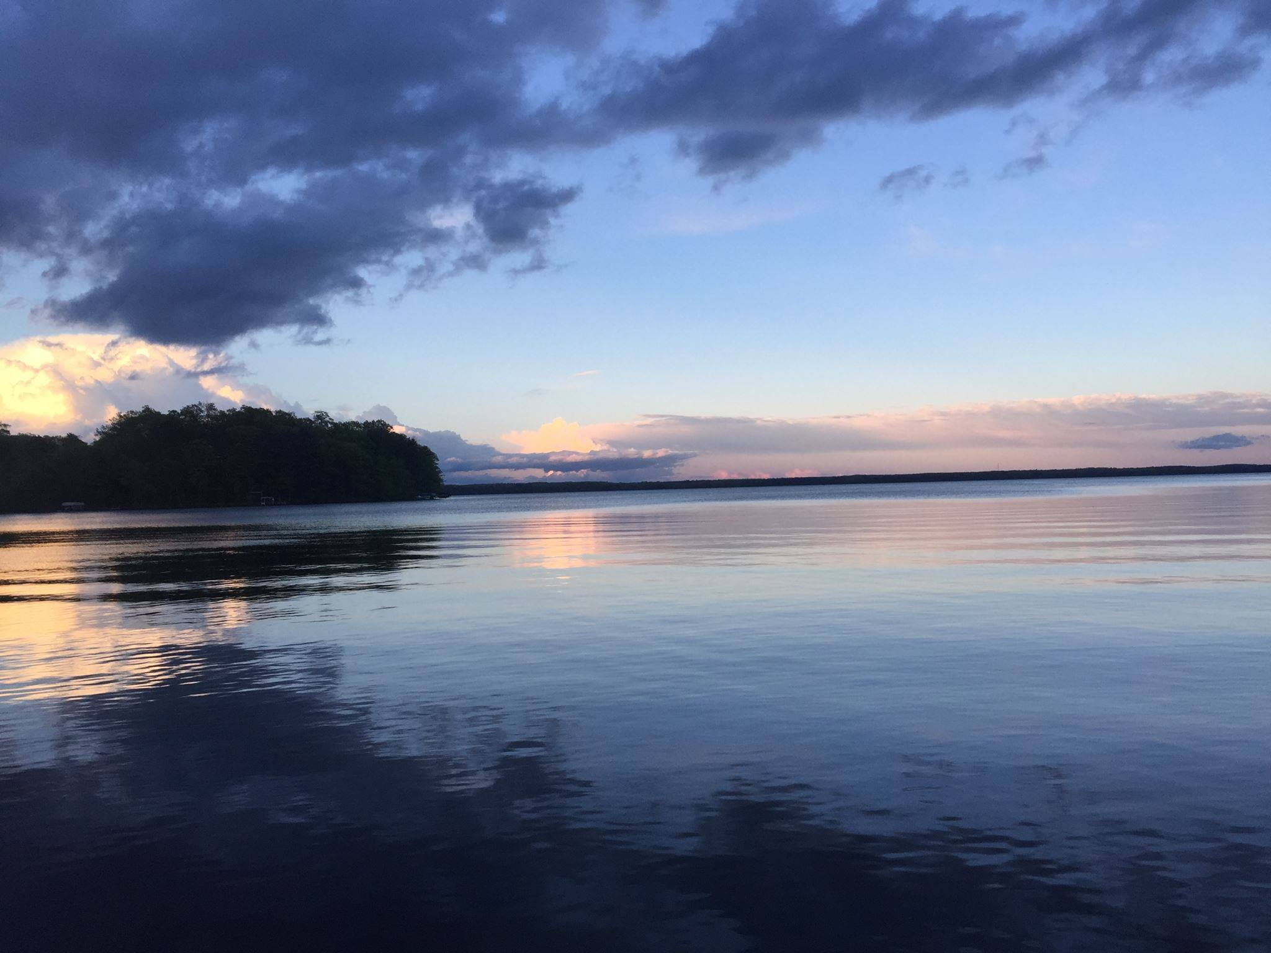


Slide 2

5TH ANNIVERSARY!

Slide 3
The Foundation’s accomplishments are due to YOU ~ OUR DONORS
THANK YOU!

Slide 8
Conservation: Protect land to support water quality and clarity; restore wetlands and native species
Legacy: Pass enjoyment of clear water lake to children, grandchildren, and future generations
Education: Provide educational opportunities to learn about the history of the land, cranberry farming, and native plants
Adds value: Maintaining water clarity has a positive impact on property values (Wold and Kemp, 2019; USA Today)
Recreation (trails for walking, hiking, running, skiing, snow shoeing, picnicking)
VISION:
CLEAR

Slide 9


Slide 10
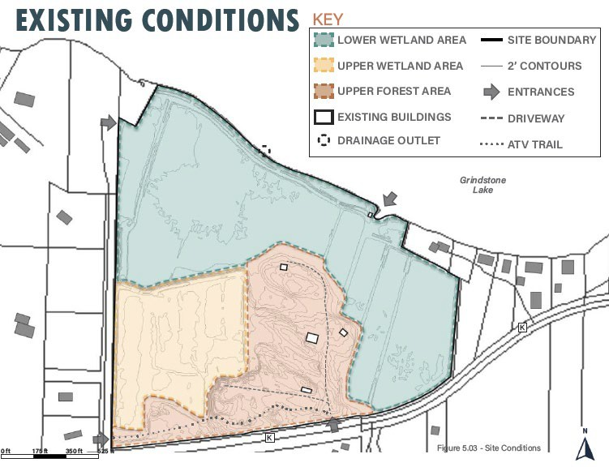


Slide 11
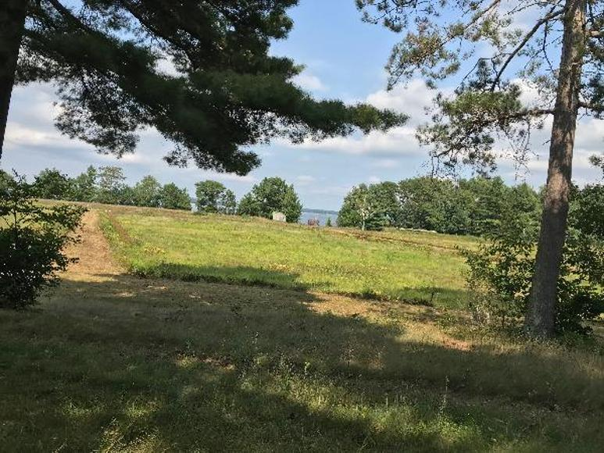
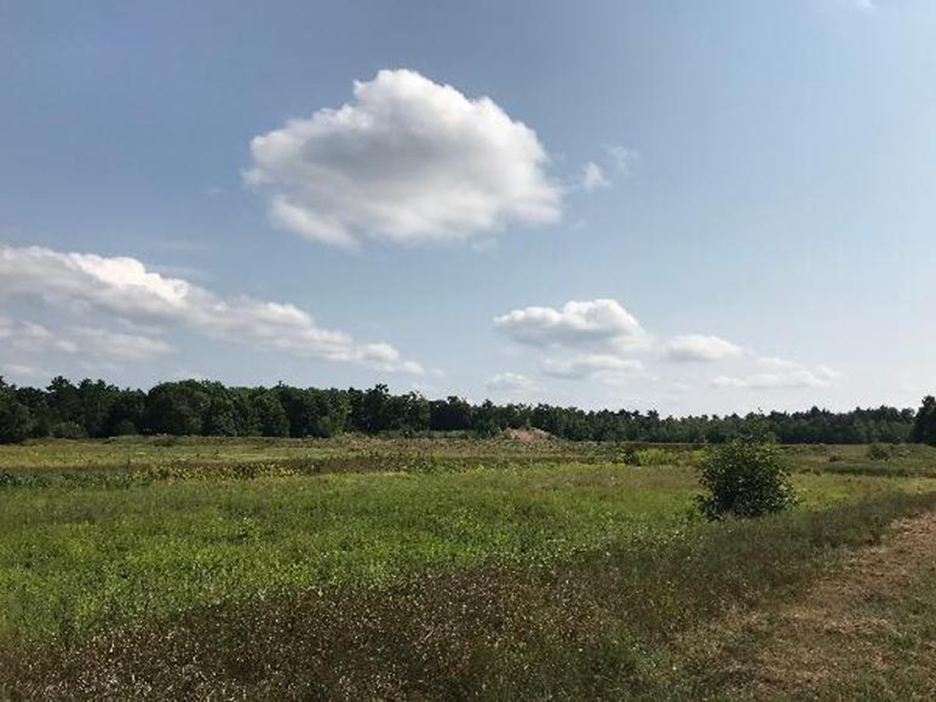
PHASE 2
CONSERVATION: Conservation Easement on the property
RECREATION: Establish basic trail system
EDUCATION: Outreach to local educational entities

Slide 12
Conservation Easement -
Property Management Plan
The primary goals of the Grindstone Lake Foundation Property Management Plan are to provide:
water quality protection through restoration and protection of wetland, shoreland, and upland portions of the property, specifically the use of native/natural landscape management, including no manicured landscaping and no additions of impervious surfaces or structures;
passive low-impact public recreational experiences; and
educational experiences and demonstration sites that provide information about the importance of wetland, shoreline and nearshore habitats and land restoration.

Slide 13
“The Grindstone Lake Foundation currently has a project acquisitioning a former cranberry bog on Grindstone Lake to provide water quality protection, provide low impact public recreation and educational experiences and demonstration of wetland, shoreline and nearshore habitats and land restoration which would be a benefit for Sawyer County for nature study.”
Sawyer County, Wisconsin Outdoor Recreation Plan 2021-2025, Page 13
Notes:
In order to obtain some federal grants, the community within which the project is located must have an Outdoor Recreation Plan. Sawyer County, Wisconsin updated their Outdoor Recreation Plan in the spring of 2021. We were discussing the bog projects with the County and they specifically included our project in their plan.

Slide 14

MASTER PLAN VISION & GOALS
Restore the natural movement of water and water holding capacity to the wetland
Aid in removing and stabilizing harmful contaminants in soil and waters
Reinforce habitats for migratory and native wildlife species
Implement passive recreational opportunities to immerse visitors in this exceptional Wisconsin resource
Provide educational opportunities regarding the sites natural, agricultural, and human histories
EDUCATIONAL SOCIAL ECOLOGICAL
Billy Acheson Landscape Architecture

Slide 15
PHASE 2

Slide 16

BOARD OF DIRECTORS
Cynthia (Cindy) Parker – President
Tony Westcot – Vice President
Michael (Mike) Warden - Treasurer
I. Reed Parker - Secretary
Donna Carlson
Cheryl Contant
Katherine (Katie) McCoid
John (Jack)Minton
Karen Mumford

Slide 17
NEXT STEPS
WE NEED YOU…
Be a part of the vision and plans for the land
Volunteer for one of our committees
  Trail establishment & maintenance
  Building assessment
  Community Outreach
  Social Media
A GEM OF AN OPPORTUNITY

