Slide 1

Grindstone Lake Association
2023 Annual Meeting
July 8, 2023

Slide 2
Agenda
Welcome and Updates – Donna Carlson
Financial – Mike Warden
Clean Water, Clean Boats – Rich Post and Melanie Schreiber, CBCW
Lake Management Plan – Karen Mumford
Committees – Cheryl Contant
Neighborhoods – Donna Carlson
Emerging Issues – Karen Mumford and Cheryl Contant
Grindstone Lake Association Governance – Donna Carlson
Grindstone Lake Foundation – Cindy Parker, Mike Warden
Guest Speaker – Eric Lundberg, President of Environmental Sentry Protection.
I-LIDS

Slide 3
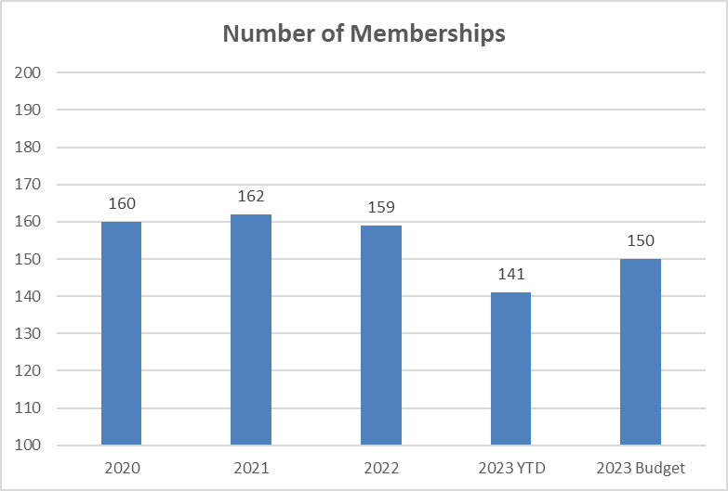
Financial Report – Memberships

Slide 4
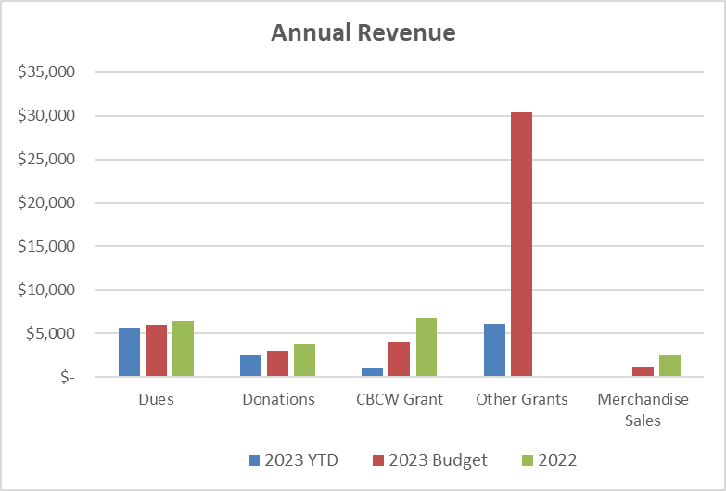
Financial Report – Revenue

Slide 5
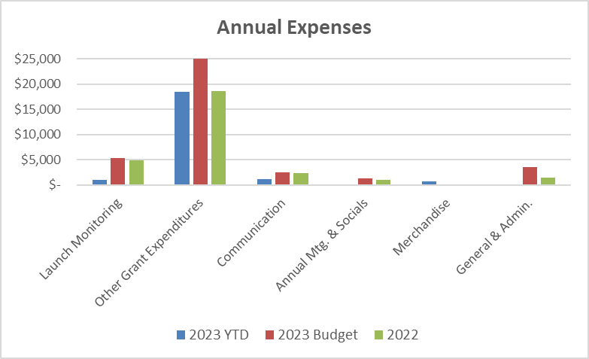
Financial Report – Expenses

Slide 6
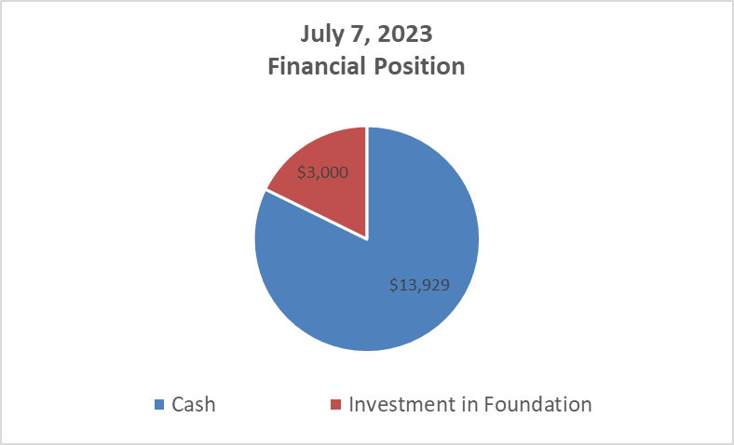
Financial Report – Financial Position

Slide 7

Clean Boats, Clean Water
Grindstone has been participating in the CBCW program since 2004
CBCW monitoring is subsidized by a grant from the WI DNR
Inspectors are trained to inspect boats and educate boaters on invasive species at public landings statewide
Grant much be matched by a minimum # of volunteer hours
  Please register to help at: https://grindstonelake.org/contact-us/
 | Grindstone Lake | Sawyer County | Statewide
Boats Inspected | 591 | 8,575 | 137,770
People Contacted | 751 | 17,914 | 273,991
Hours Spent | 344 | 5,283 | 85,456

Slide 8
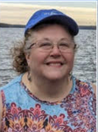
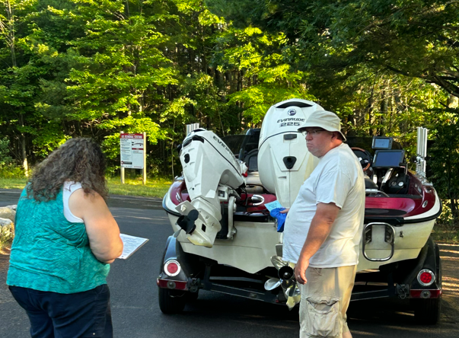
Clean Boats, Clean Water
Meet Melanie Schreiber, Grindstone’s 2023 CBCW Monitor
Resides in Turtle Lake, WI and grew up in the Spooner area
Has many years experience as a CBCW monitor – and it’s a family affair!
Possesses a passion for our great lakes and a drive to keep them clean
Stationed at Grindstone’s main public landing off Hwy K
Monitoring hours are 7:00am – 12:00 pm (Fri-Sun + Holidays)

Slide 9
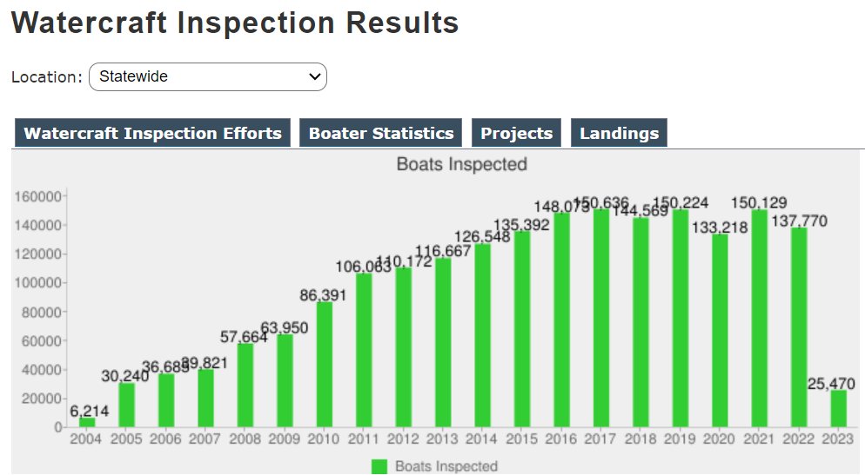
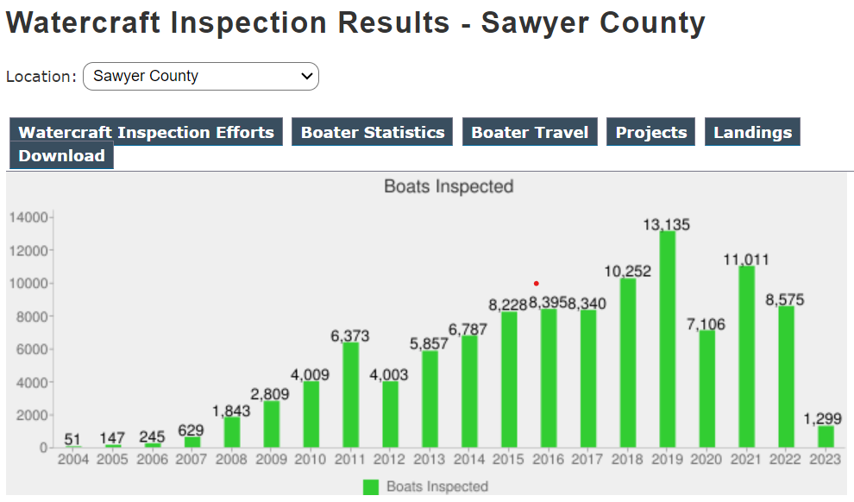
Clean Boats, Clean Water

Slide 10
Comprehensive Lake Management Plan

Slide 11
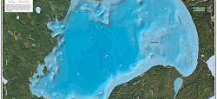
Purposes
Assess Grindstone Lake’s condition and quality to protect and inform future management of the lake
Access Lake Management Implementation Funds from DNR

Slide 12
Comprehensive Lake Management Plan
Preparation Timeline 2021-2023
  Current Status: under review by DNR for final approval
  Review plan at GLA website: grindstonelake.org
10-Year Planning and Implementation Document
  Identifies threats, problems, causes
  Incorporates community and its goals
  Develops implementation strategies schedule
  Updated regularly

Slide 13
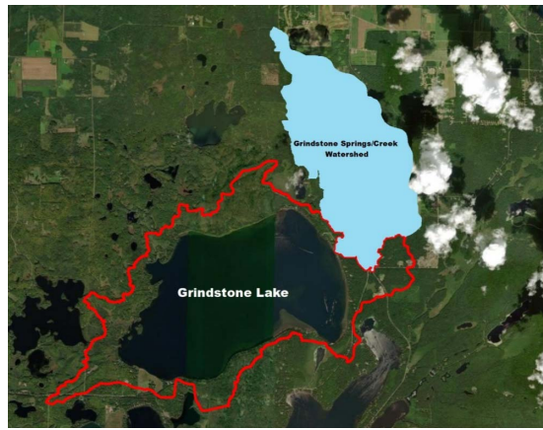
Plan Scope
  Grindstone Lake
  Tributaries
  Shoreline and shoreland
  Watershed
  Lake residents and visitors

Slide 14



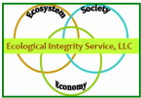

Lake Citizen-Professional Collaboration
  $25,000 DNR grant (67% of costs)
    Fund Professional Services
      Plan Management and Development (Harmony Environmental)
      New and Archival Data Collection (Ecological Integrity Services) Water chemistry; fisheries; aquatic plant survey (native and invasive); watershed, hydrology, and land use; lakeshore/riparian habitat, and MORE…
  Volunteer and in-kind services and contributions (33% of costs)
      Electronic survey of lake home-owners conducted by University of Wisconsin Eau Claire and GLF board members
      Hours served during committee meetings

Slide 15
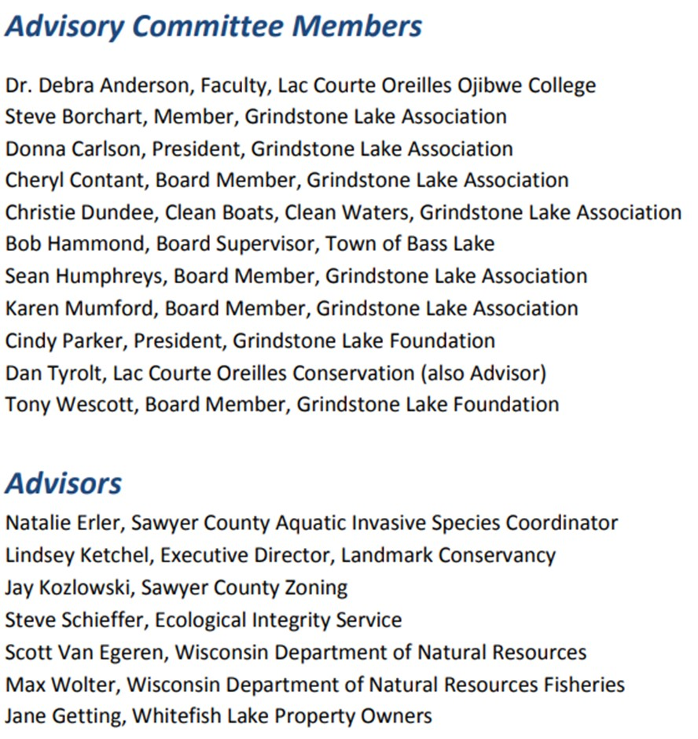

Slide 16
Comprehensive Lake Management Plan Goals
Preserve excellent lake water quality
Prevent the introduction of aquatic invasive species (AIS)
Respond rapidly to new introductions of AIS and reduce the impacts of established AIS
Support a healthy and diverse fishery as guided by the Grindstone Lake Fishery Management Plan
Support healthy native aquatic plant communities
Support the efforts of the Grindstone Lake Association with an engaged lake community

Slide 17
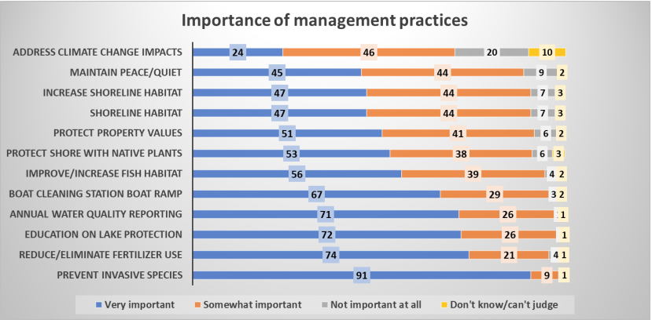
Comprehensive Lake Management Plan Goals

Slide 18
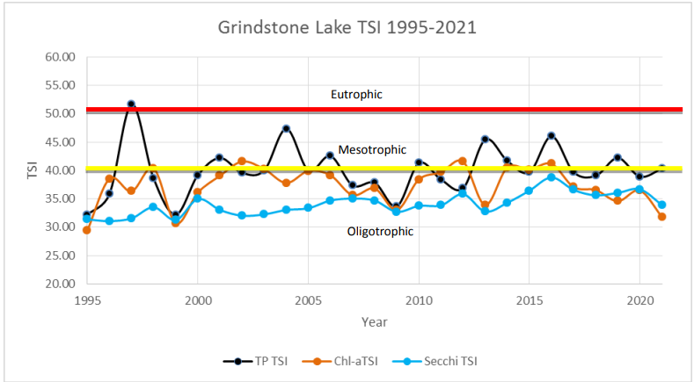
Comprehensive Lake Management Plan Goals
Grindstone Lake Trophic State Index 1995-2021
Total Phosphorus TSI Chlorophyll-a TSI Secchi TSI

Slide 19
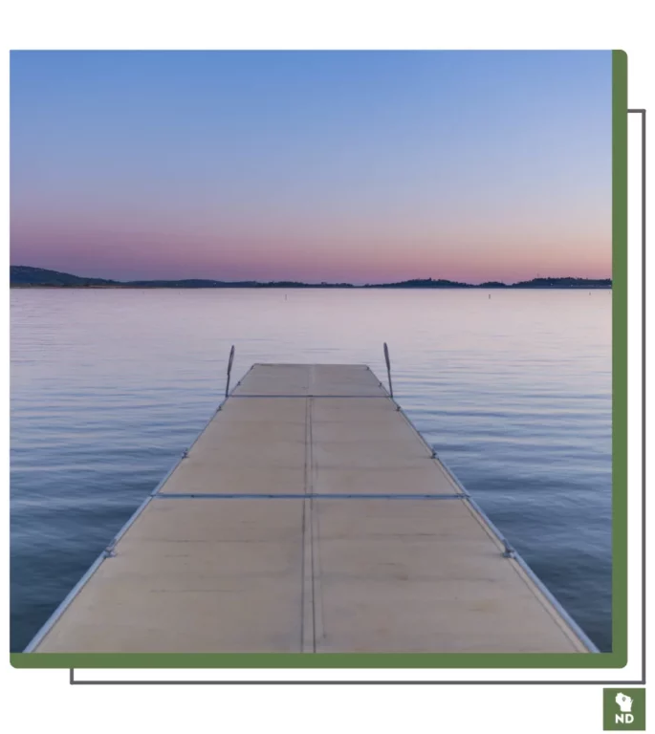
Comprehensive Lake Management
The Comprehensive Lake Management Plan for Grindstone Lake provides a blueprint for preserving lake water quality and native habitats, preventing introduction of invasive species, and supporting long-term ecological health….
…Now our lake and our community need your help…

Slide 20
Lake Management Plan Implementation
Committees

Slide 21
Proposed Committee Structure for GLA
Aquatic Invasive Species (AIS), both plants and animals, includes CBCW, citizen monitoring, rapid response to new introductions
Fishery and Habitat (F&H) includes coordinating with WiDNR and working with shoreline and shoreland protection
Shoreline and Shoreland Protection and Restoration (SSPR) includes Healthy Lakes grant program and technical assistance on shoreland plantings, rain gardens, fertilizer and pesticide prevention

Slide 22
Proposed Committee Structure for GLA
Grants (GR) includes application and grant administration
Water Quality (WQ) includes citizen-based monitoring, coordinating with LCO Conservation Dept, and watershed land use planning
Building a Grindstone Lake Community (BGLC) includes developing educational materials for visitors, landowners, new residents; coordinating with neighborhoods, increasing membership and community outreach

Slide 23
Comprehensive Lake Management Plan Goals
Preserve excellent lake water quality. (WQ, SSPR, BGLC)
Prevent the introduction of aquatic invasive species. (AIS, GR)
Respond rapidly to new introductions of aquatic invasive species and reduce the impacts of established AIS. (AIS, GR)
Support a healthy and diverse fishery as guided by the Grindstone Lake Fishery Management Plan. (F&H, WQ, AIS, GR)
Support healthy native aquatic plant communities. (SSPR, WQ, BGLC, GR)
Support the efforts of the Grindstone Lake Association with an engaged lake community. (BGLC, GR)

Slide 24
It Takes Us All…Select Your Committee…
Aquatic Invasive Species (AIS) includes CBCW, citizen monitoring, rapid response to new introductions
Fishery and Habitat (F&H) includes coordinating with WiDNR and working with shoreline and shoreland protection
Shoreline and Shoreland Protection and Restoration (SSPR) includes Healthy Lakes grant program and shoreland plantings, rain gardens
Grants (GR) includes application and grant administration
Water Quality (WQ) includes citizen-based monitoring, coordinating with LCO Conservation Dept, and watershed land use planning
Building a Grindstone Lake Community (BGLC) includes developing educational materials; coordinating with neighborhoods, increasing membership and community outreach

Slide 25
Grindstone Lake Neighborhoods

Slide 26
Example:
Building Community on Our Lake
Building Our Lake Community
Introducing Lake Neighborhoods
Defined by Site Address of Lake Property Owners
Find Your Site Address and Remember Your Neighborhood Number

Slide 27
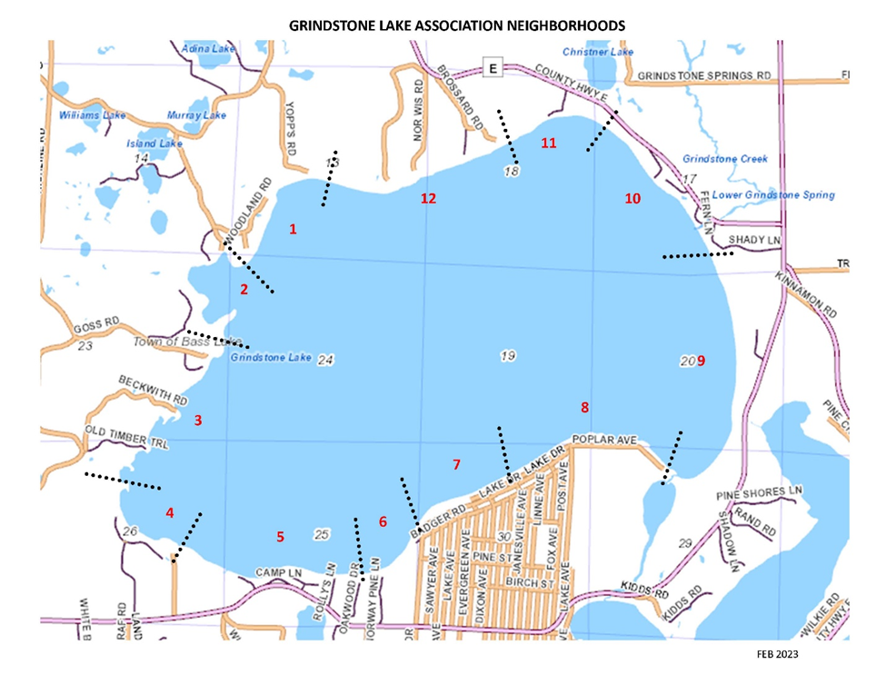

Slide 28
Zone Delineations
Neighborhood Delineation
# 1
  All on Woodland Road, Hilltop Road, Yopps Road
# 2
  All on Cherokee Trail, West Shore Lane, and Williams Resort Road
# 3
  All on Goss Road, Beckwith Road, Highline Road, and Maple Lane

Slide 29
Neighborhood Delineation
#4
  All on Gross Point Drive, Grindstone Landing Road, Birch Island Road, and Stone Bay Lane
#5
  All on Mallard Lane, Camp Lane, Rolly’s Lane, and Oakwood Drive, and 14698W thru 14810W and 7748N County Hwy K
#6
  All on Norway Pine Lane and Indian Drive, and 14590W thru 14602W County Hwy K

Slide 30
Neighborhood Delineation
#7
  All on Lake Drive and 14244W thru 14392W Poplar Lane
#8
  14004W thru 14240W Poplar Lane
#9
  All on Blackberry Lane; 7997N thru 8471N County Hwy K

Slide 31
Neighborhood Delineation
#10
  All on Fern Lane, Blue Spruce Lane, Sunset Ridge Lane, Shady Lane, and 13877W thru 14069W County Hwy E
#11
  All on Omajik Lane and 14083W thru 14259W County Hwy E
#12
  All on Coppersmith Road, Brossard Road, Norwis Road, and Ridge Road

Slide 32
Neighborhood Leaders’ Responsibilities**
Know your neighbors
  Welcome package with invitation to join GLA
    Welcome chat etc.
    A Guide for Lake Living etc. brochures distributed
  Identify properties or homes for sale, purchased, rented, under construction
Build Community
  Periodic picnic/community building per neighborhood
  Create a texting/email/phone tree group
  Neighborhood Watch
Observe/Monitor Grindstone Lake
  Rapid Response reporting for AIS
  Loon activity and monitoring
  Observing changes in the lake or shoreline that you think might be important
** Note: 1-2 Leaders would serve on BGLC (Building Grindstone Lake Community) committee

Slide 33
Neighborhood Leaders
Grindstone Lake Association Neighborhoods
Neighborhood # | Includes properties on the following street names and fire code addresses | Neighborhood Leader | Alterntate or Co-Leader
1 | All on Yopps Rd All on Woodland Rd All on Hilltop Rd
2 | All on Williams Resort Rd All on Cherokee Trail All on West Shore Ln | David and Mary Kieffer mdkieffer@comcast.net 651 785 5213 | Mark and Nancy Daubenberger mdaubenberger@msn.com 612 839 5237
3 | All on Goss Rd All on Maple Ln All on Beckwith Rd All on Old Timber Trail All on Highline Rd | Jamie Gitter kjgitter@comcast.net 651 216 4503
4 | All on Stone Bay Ln All on Gross Point Dr All on Birch Island Rd All on Grindstone Landing Rd | Jane Marquard jamarquard@comcast.net 612 483 4228
5 | All on Valhalla Dr All on Camp Ln 14810 County Hwy K All on Mallard Ln All on Rollys Ln All on Oakwood Dr 14698W County Hwy K | Anthony (Tony) Westcot twestcot@me.com 952 239 8810
6 | 14590W - 14602W County Hwy K All on Norway Pine Ln All on Indian Dr
7 | All on Lake Dr Poplar Ln from 14244W (west of John Morton Ln) thru 14392W | Kathy Fitzgerald 715 558 1825
8 | Poplar Ln from 14004W thru 14240W (east of John Morton Ln) |  | Kathy Fitzgerald 715 558 1825
9 | County Hwy K from 8121N thru 8471N All on Blackberry Ln | Lorna Gleason twgleason@gmail.com 952 846 8110
10 | All on Shady Ln All on Fern Ln All on Blue spruce Ln All on Sunset Ridge Ln County Hwy E from 13877W thru 14083W
11 | County Hwy E from 14095W thru 14183W All on Omajik Ln | Jacqueline & Jon Brunsberg jacque.brunsberg@gmail.com 651 587 6047
12 | All on Brossard Rd All on Ridge Dr All on Norwis Rd All on Coppersmith Rd | Carol Lamb sclamb5@comcast.net 651 829 4833 | Keith Orner keithorner@comcast.net 612 875 6052

Slide 34
Grindstone Lake
Emerging Issues

Slide 35
Emerging Issues: Invasive Species
Invasive Species in Little Grindstone
  Curly Leaf Pondweed present – No aggressive management needed
  Eurasian Water Milfoil (EWM) fragments (turions) found in Little Grindstone in 3 locations
    Likely from LCO
    “The EWM is very close to Grindstone, and the potential for introduction is relatively high.”

Slide 36
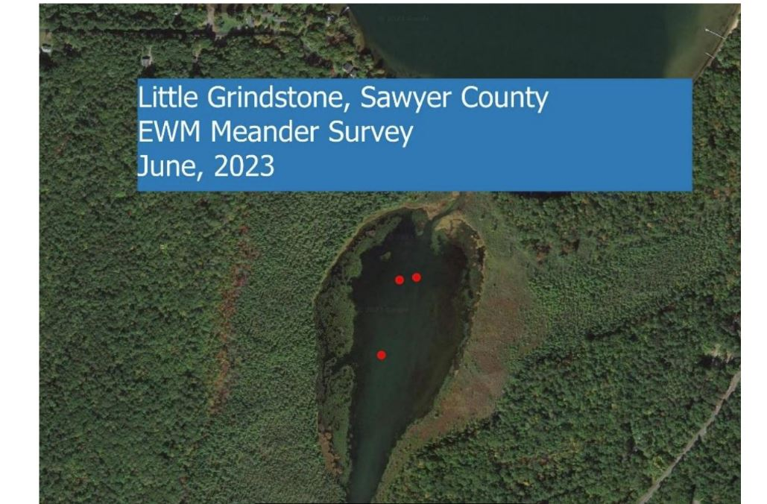

Little Grindstone

Slide 37
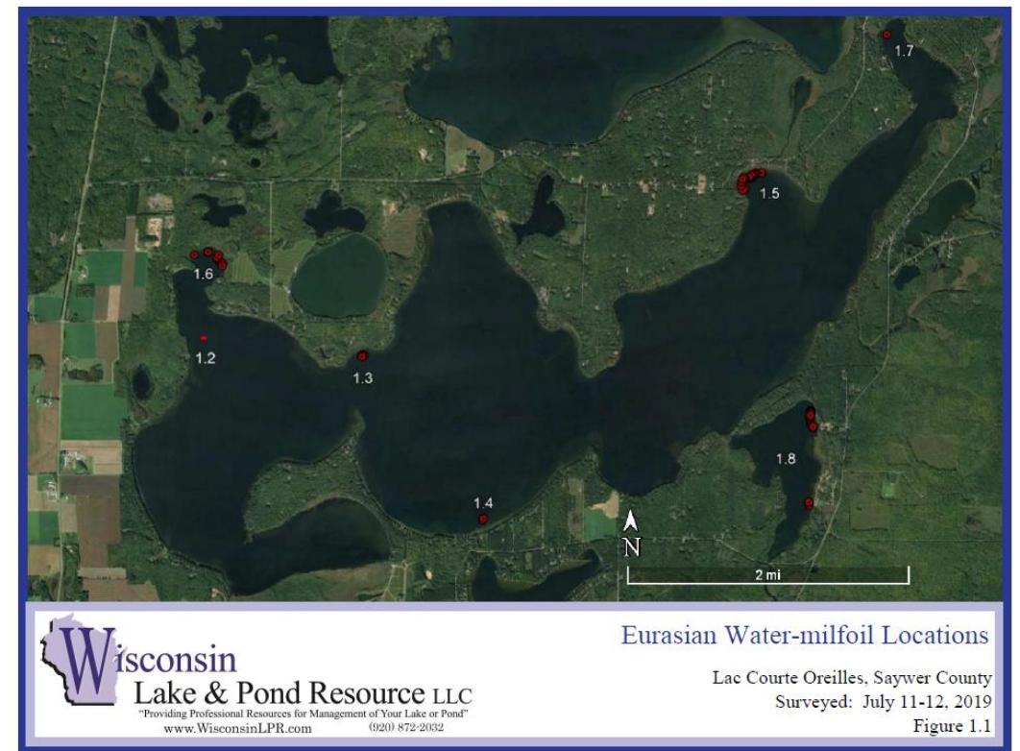
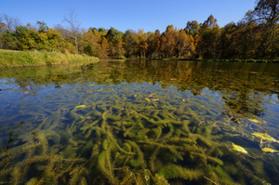

Slide 38
Emerging Issues: Invasive Species
    PLEASE STOP (OR LIMIT) BOAT/PWC MOVEMENT BETWEEN LCO AND GRINDSTONE TO PREVENT INTRODUCTION OF EWM (Eurasian Water Milfoil).
    ALL RESORTS HAVE PLENTY OF PARKING FOR AUTOMOBILES
    WHEN LEAVING LCO, PLEASE REVERSE YOUR MOTOR RIGHT AFTER YOU GO UNDER COUNTY HWY K BRIDGE

Slide 39
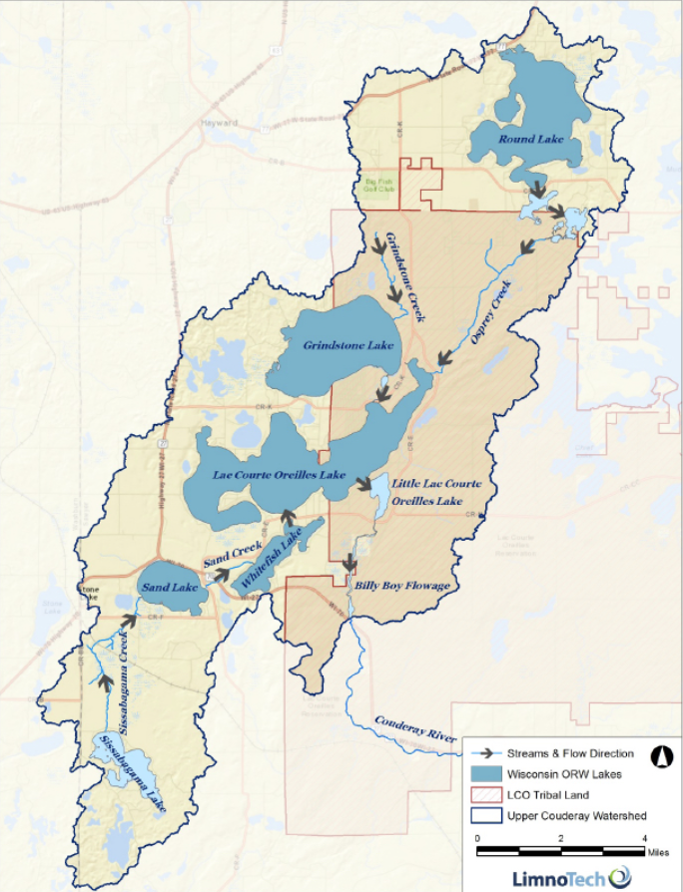
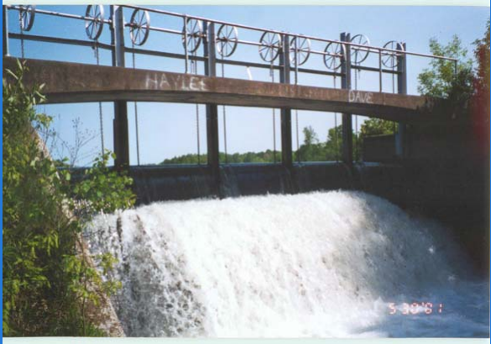
Emerging Issues
Emerging Issues: Water Levels
Lake Levels
Billy Boy Dam
Billy Boy Dam

Slide 40
Historical Management
1935 Grindstone And LCO lake residents request old logging dam be updated to maintain water levels
1942 High water levels led to widening of 2 bridges upstream of dam to increase flow downstream
1954 Public Service Commission of WI (PSC) required moveable gates to be installed
1955 Under authority of Section 31.02, Statutes PSC established:
  Max level 97.3 feet
  Min level 96.8 feet
Sawyer Co. now managing according to PSC policy

Slide 41

How Balance Values and Interests?
 | Ability to launch boats from lift
Water flow to Little Couderay River |  | Navigation Hazards
 | Lake Levels
Shoreland flooding |  | Transportation between Grindstone and LCO
Plant, fish and animal habitat
 | Bank and Shoreline Erosion

Slide 42

Options
Currently reviewing locations and accuracy of gauges
May need to recommend hydrological study of watershed
Based on data, consultation with Sawyer Co, WIDNR, and PSC, consider new statute to adjust 1955 order
Other steps?? …to be continued…

Slide 43
Board of Directors (for Review and Approval for 2023-2024)
Officers
Donna Carlson – President
Michael (Mike) Warden – Treasurer
Cynthia (Cindy) Parker – Secretary
Board Members
Cheryl Contant – Membership
David Kieffer – Communications
TBD – Clean Boats, Clean Water
Sean Humphreys – Shoreline Restoration
Karen Mumford – Lake Management Plan
Greg Klausen - TBD
TBD - Web & Social Media Management
TBD – Annual Meeting, Outreach & Social Activities

Slide 44
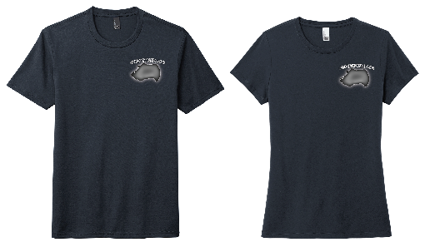

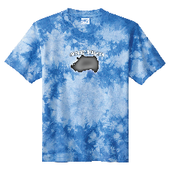
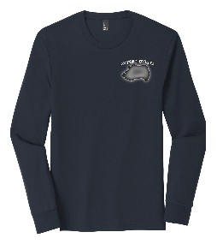
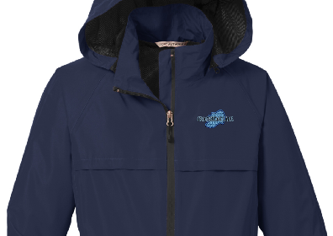

Reminder – Saturday, July 8, 2023
Order at: https://stores.inksoft.com/grindstonelake OR
https://grindstonelake.org/grindstone-lake-logo-wear
Grindstone Lake Social: 3-5:00 PM
The Boulevard – Cash Bar, Snacks
Grindstone Lake Gear: July 1 – 16, 2023
Order at: https://stores.inksoft.com/grindstonelake OR
https://grindstonelake.org/grindstone-lake-logo-wear

Slide 45
THANK YOU!!!
Newsletter Design and Production - Dee Hobbie
Loon Monitoring - Jane and Randall Linton
Neighborhood Leaders
All Volunteers
New and Renewing GLA members

Slide 46
Guest Speaker
Our guest speaker is Eric Lindberg, President of Environmental Sentry Protection. Eric will provide an overview of the I-LIDS device installed at the Grindstone Lake DNR boat landing on K.(I-LIDS stands for Internet Landing Installed Device Sensor)

