Slide 1

Grindstone Lake Association
2024 Annual Meeting
July 6, 2024

Slide 2
Agenda
Welcome and Updates – Donna Carlson
Financial Update – Mike Warden
Clean Water, Clean Boats – Greg Klausen, CBCW
Aquatic Invasive Species (AIS) – Cheryl Contant
Oxythermal Habitat Grant – Karen Mumford
Grindstone Lake Community – Donna Carlson
Water Level Update – Greg Klausen
Grindstone Lake Association Governance – Donna Carlson
Grindstone Lake Foundation – Cindy Parker, Mike Warden
Guest Speaker – Max Wolter, Senior Fisheries Biologist, WDNR

Slide 3
Financial Update
Mike Warden

Slide 4
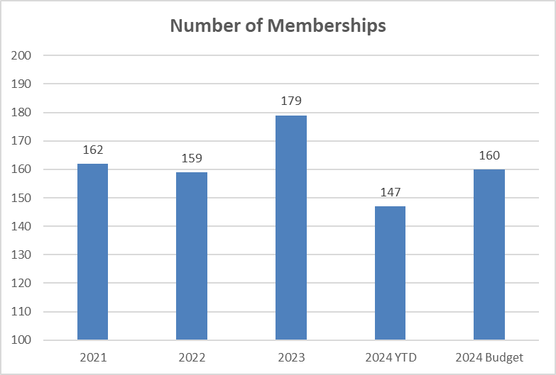
Financial Report – Memberships

Slide 5
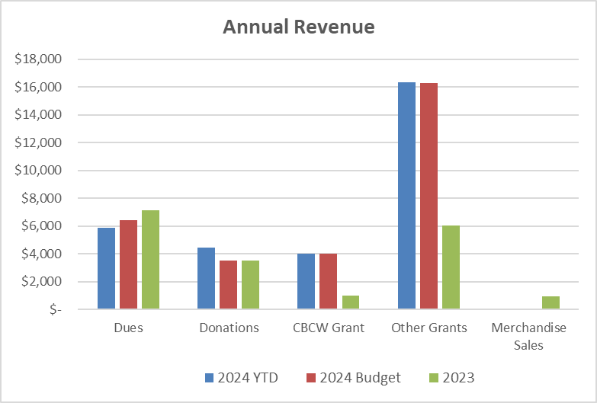
Financial Report – Revenue

Slide 6
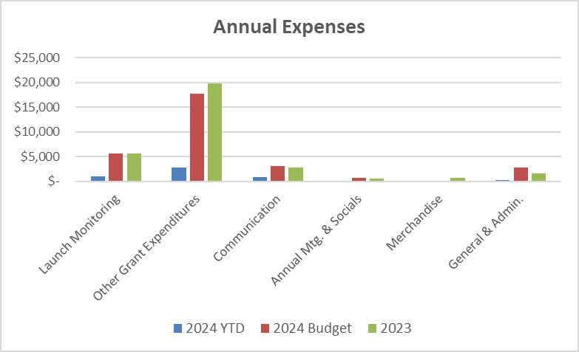
Financial Report – Expenses

Slide 7
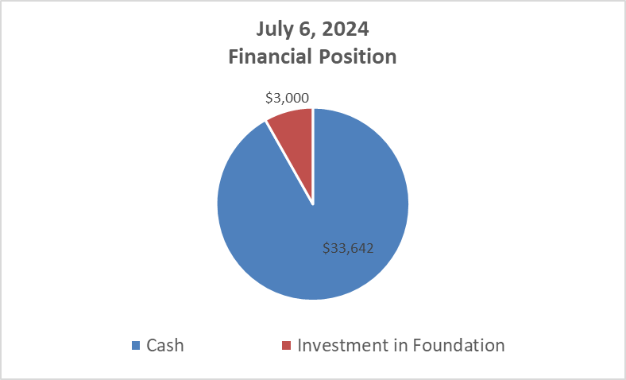
Financial Report – Financial Position

Slide 8
Clean Boats, Clean Water
Greg Klausen

Slide 9

Clean Boats, Clean Water
Grindstone has participated in CBCW program since 2004
CBCW monitoring is subsidized by a grant from the WI DNR
Inspectors are trained to inspect boats and educate boaters on invasive species at public landings statewide
Grant much be matched by a minimum # of volunteer hours
  Please register to help at: https://grindstonelake.org/contact-us/
2023 | Grindstone Lake | Sawyer County | Statewide
Boats Inspected | 1,112 (+88%) | 11,619 (+35%) | 154,500 (+12%)
People Contacted | 2,251 (+199%) | 25,124 (+40%) | 302,802 (+10%)
Hours Spent | 314 (-9%) | 5,799 (+10%) | 83,283 (-2.5%)

Slide 10
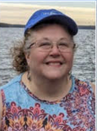
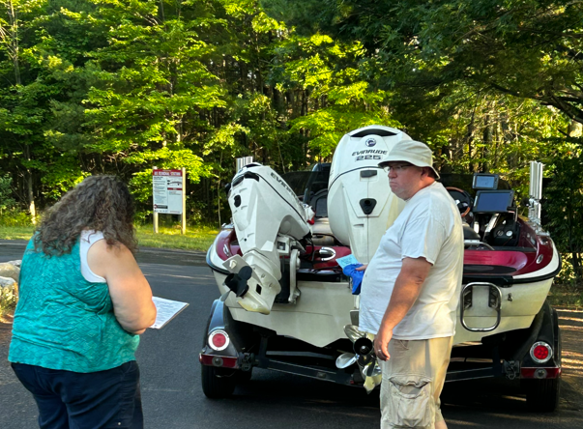
Clean Boats, Clean Water
Meet Melanie Schreiber, Grindstone’s 2024 CBCW Monitor
Resides in Turtle Lake, WI and grew up in the Spooner area
Has many years experience as a CBCW monitor – and it’s a family affair!
Possesses a passion for our great lakes and a drive to keep them clean
Stationed at Grindstone’s main public landing off Hwy K
Monitoring hours - 7:00am – 12:00 pm
(Fri-Sun + Holidays)

Slide 11
I-LIDS Update
2023
  Date Installed - 5/25/23
  Date De-installed - 10/26/23
  Videos Captured - 10,283
  % of boat launch videos reviewed – 23%
  Suspect AIS Violations - 1
  Hours of operation - 5am - 1am
  Total hours of inspection time – 3,080
2024
  Date Installed - 4/26/24
  Relocated to West of boat launch ramp

Slide 12
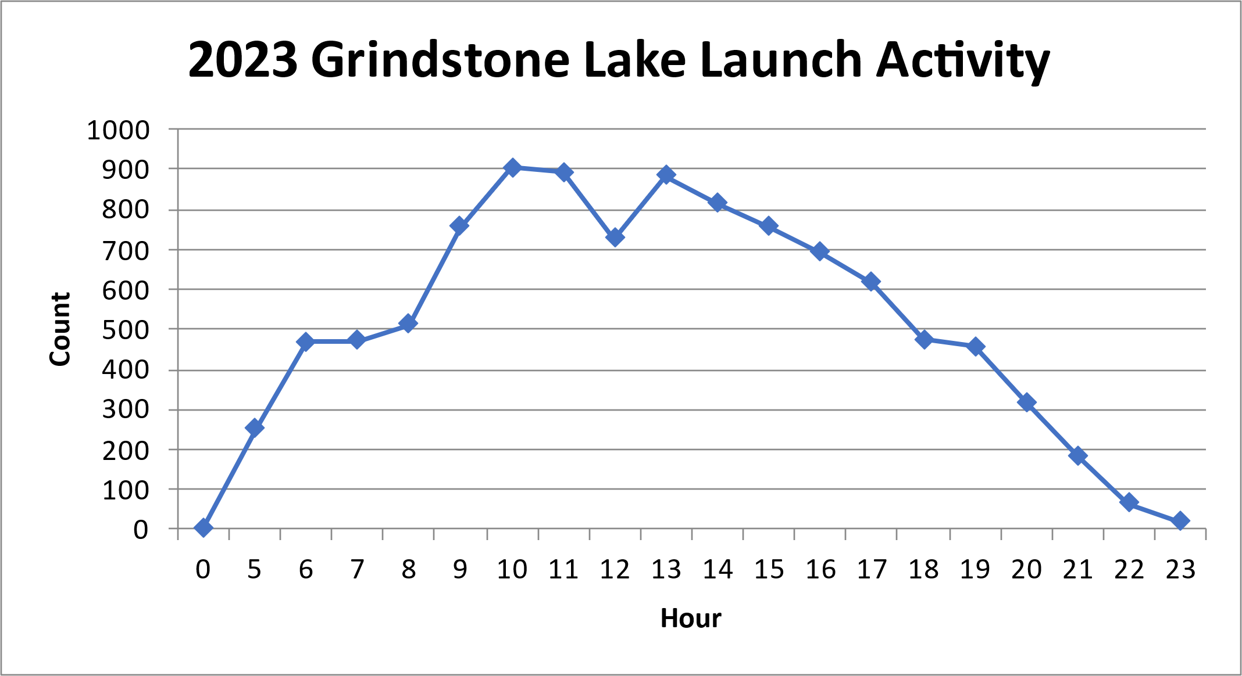
I-LIDS Launch Activity – Time of Day
Peak Launch Activity: Time of Day - 10 AM – 1 PM

Slide 13
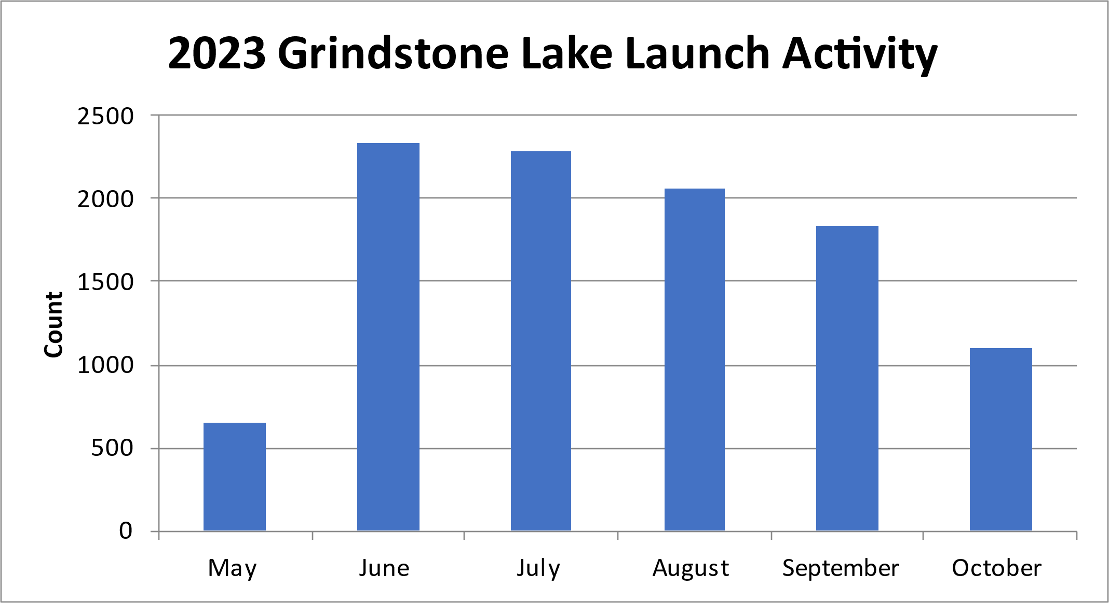
I-LIDS Launch Activity – Month
Peak Launch Activity: Month – June & July

Slide 14
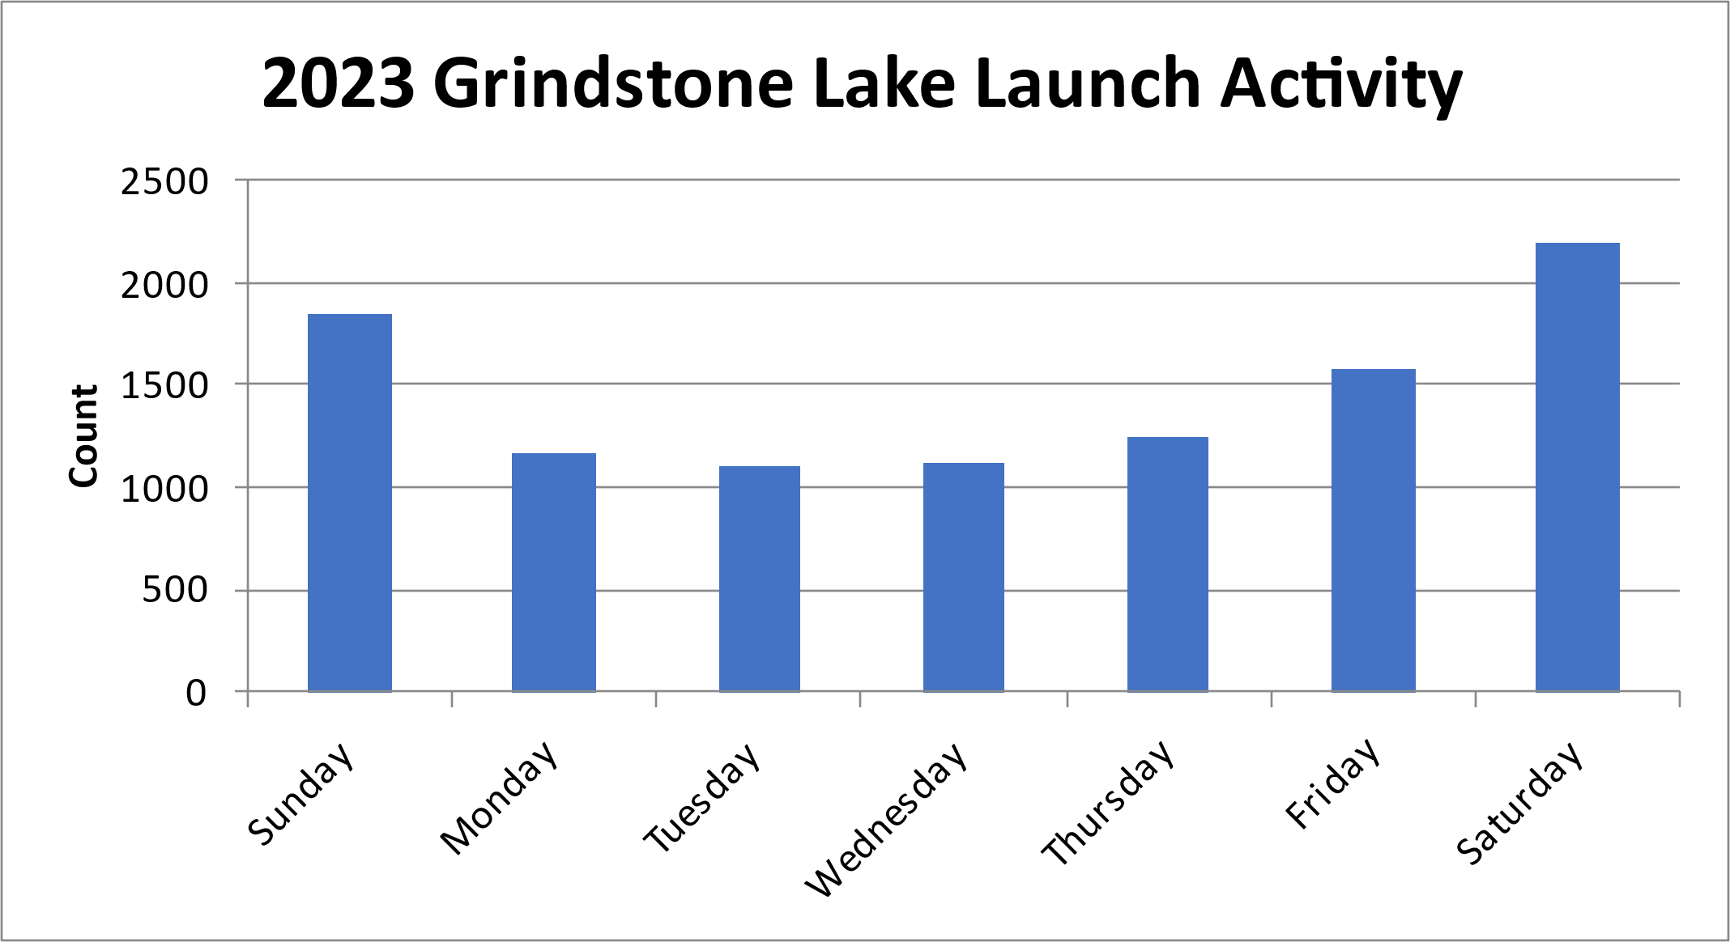
I-LIDS Launch Activity – Day of Week
Peak Launch Activity: Day of week – Saturday - Sunday

Slide 15
Aquatic Invasive Species (AIS)
Cheryl Contant

Slide 16
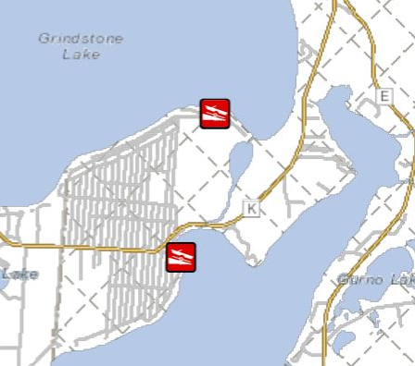
Little Grindstone Lake

Slide 17
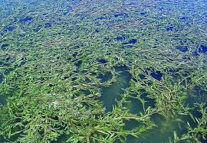
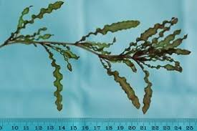
Little Grindstone Lake
Aquatic Invasive Species:
Known history of Curly Leaf Pondweed (discovered 2006; treated chemically in 2010; ineffective)
Early season plant, small beds, dies off in June

Slide 18
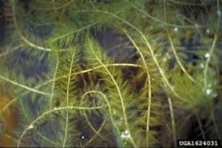
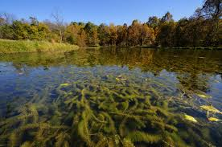
Little Grindstone Lake
Aquatic Invasive Species:
Discovery of Eurasian Water Milfoil in June, 2023
No large beds but plants found in several locations
Most likely coming from Anchor Bay in LCO
Lac Courte Oreilles

Slide 19
Little Grindstone Lake AIS
Applied for (Nov 2023) and received (March 2024) AIS Population Control Grant for $17,700 for 2024-25
AIS meander surveys to locate CLP and EWM (2 per year)
SCUBA divers hand pull CLP and EWM (2 per year)
First survey confirmed CLP and EWM presence and locations
First Dive in June 2024

Slide 20
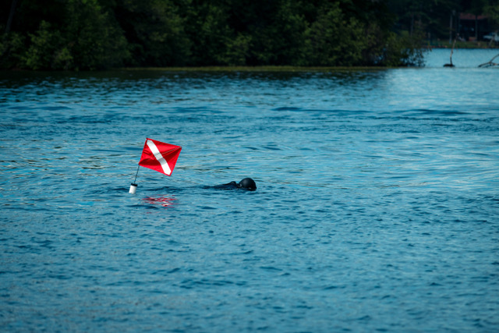
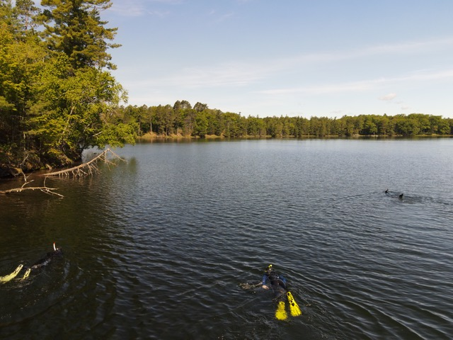
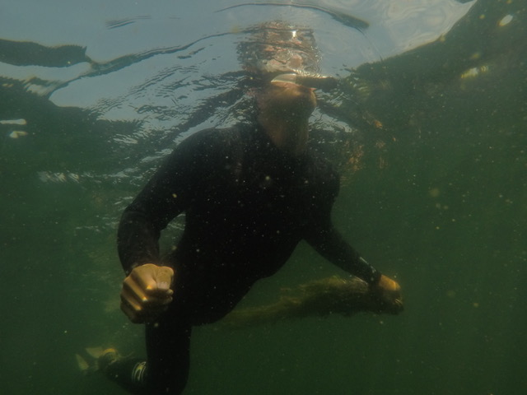
Little Grindstone Lake AIS
SCUBA divers hand pull plants from the roots

Slide 21
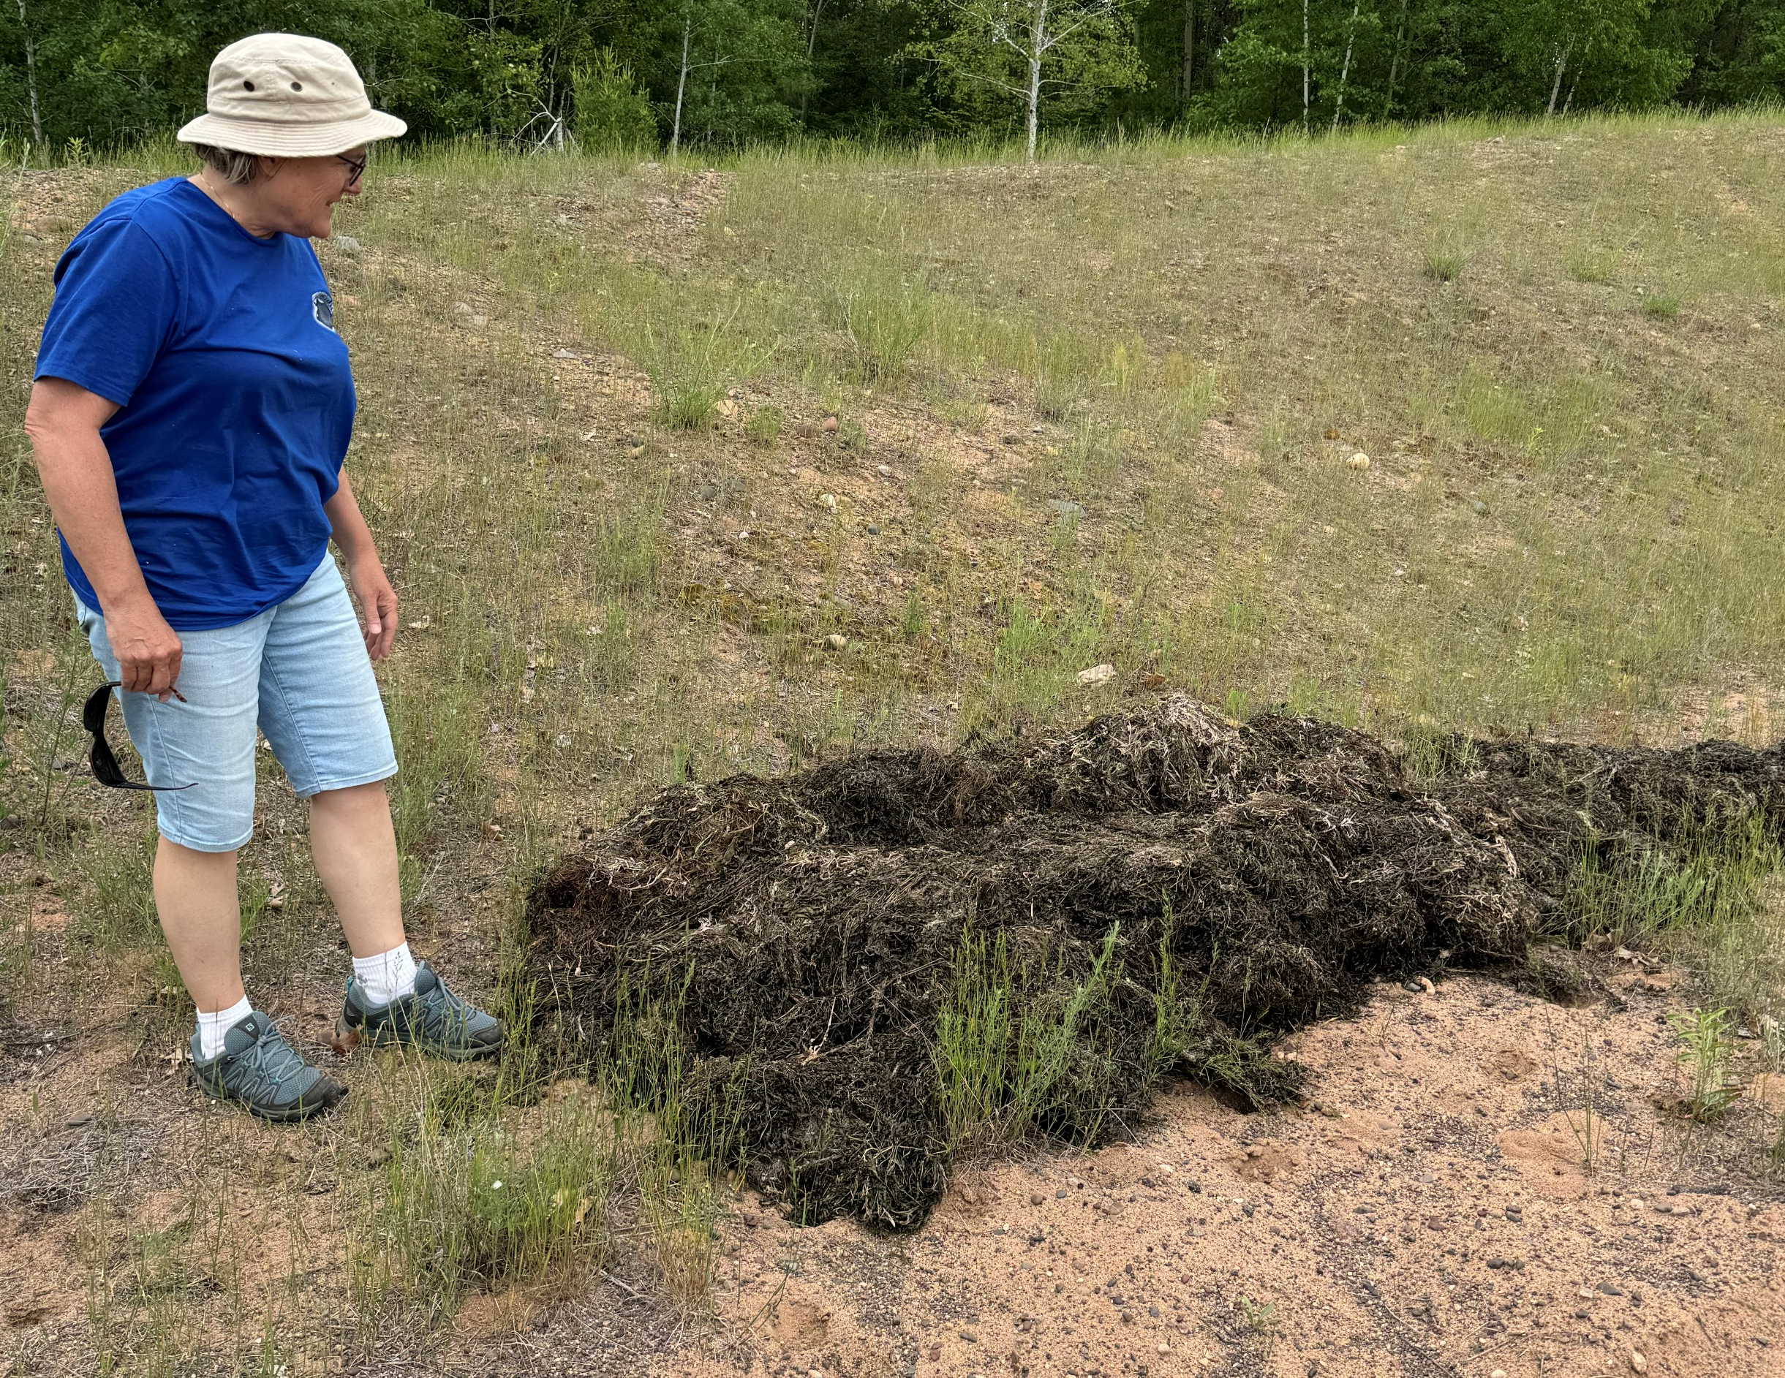
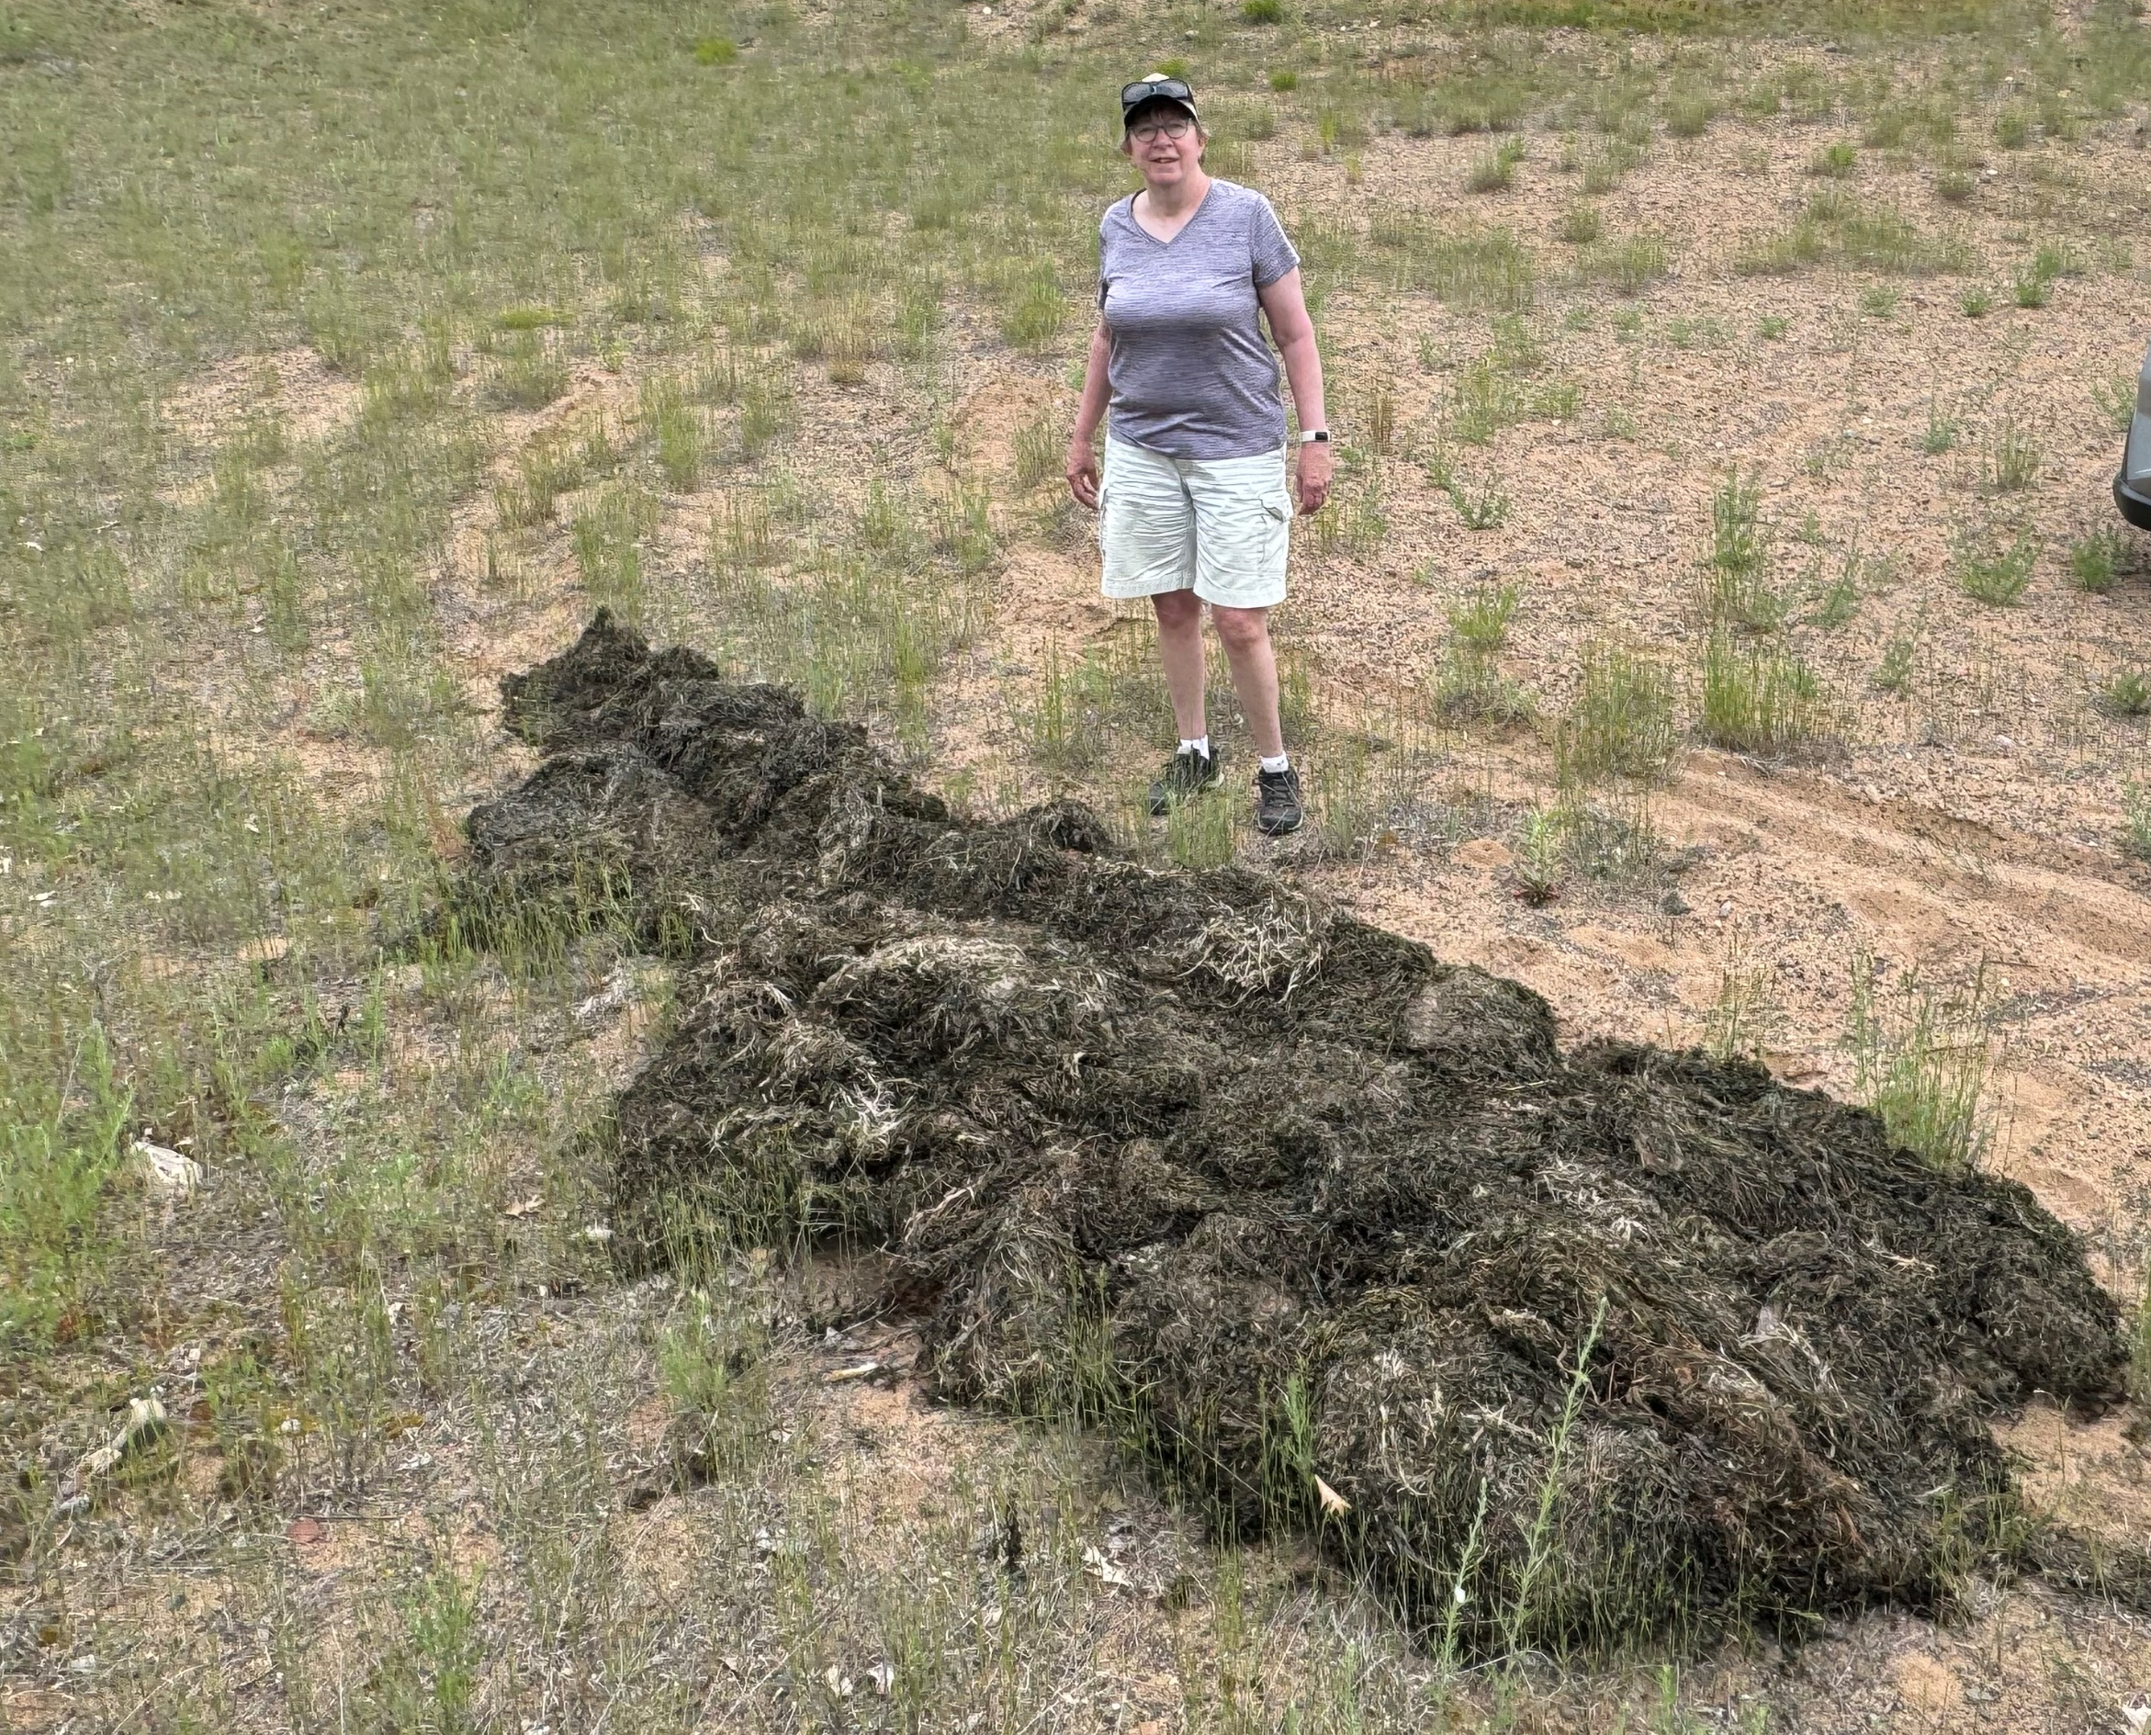
Little Grindstone Lake AIS
SCUBA divers: Hand-pulled 63 cubic feet of AIS in 1 day

Slide 22
Little Grindstone Lake AIS
Upcoming This Summer:
One more hand pulling targeting EWM
Meander survey to determine effectiveness of hand pulling
Next Summer:
Survey – Hand Pulling – Hand Pulling – Survey
Consider Another Grant

Slide 23
Little Grindstone Lake AIS
PLEASE HELP STOP THE SPREAD
When entering Little Grindstone Lake from LCO, PLEASE reverse your engine and check propeller for “hitchhikers”
Keep the entirety of Little Grindstone channel and lake as a “SLOW, NO WAKE” Zone

Slide 24
Fisheries & Habitat
Karen Mumford

Slide 25
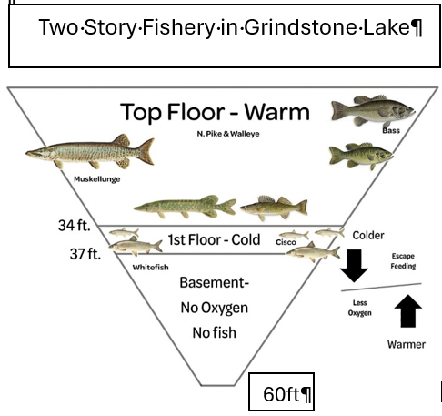
Grindstone Lake Oxythermal Habitat Study

Slide 26
Grindstone Lake Oxythermal Habitat Study
Over 190 Two-Story Lakes in WI
Five Two-Story Lakes in Sawyer Co.
  Ashegon Lake
  Grindstone Lake
  Lac Courte Oreilles
  Round Lake (Big Round)
  Whitefish Lake

Slide 27
Grindstone Lake Oxythermal Habitat Study
Following summer stratification, support for cold water species requires:
  A layer at least 1 meter in thickness
  Dissolved oxygen concentration of at least 6 mg/L
  Maximum temperature of
    Cisco 73 F
    Lake Whitefish 66 F
WisCalm, 2024, WI DNR

Slide 28
Grindstone Lake Oxythermal Habitat Study
Due to a warming climate and
increasing lake productivity,
is Grindstone Lake’s Two-Story
fishery habitat disappearing
during the summer?

Slide 29
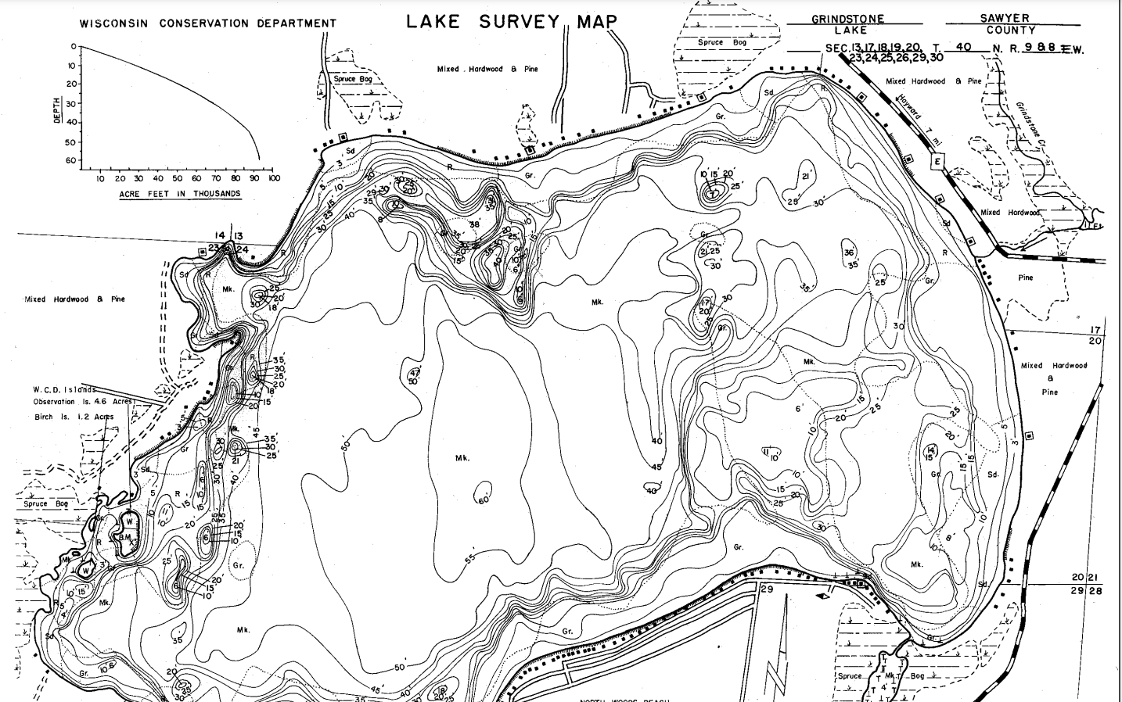
Data Collection
Sample
  60 ft hole
  Bimonthly
  Ice out until October

Slide 30
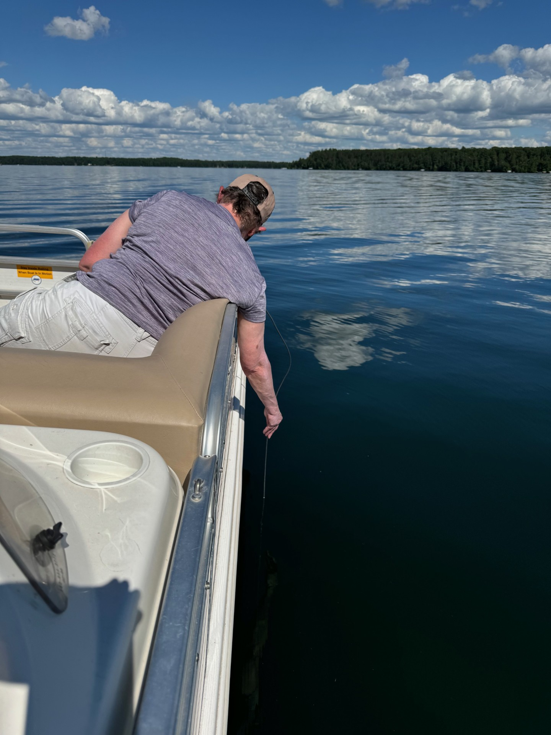
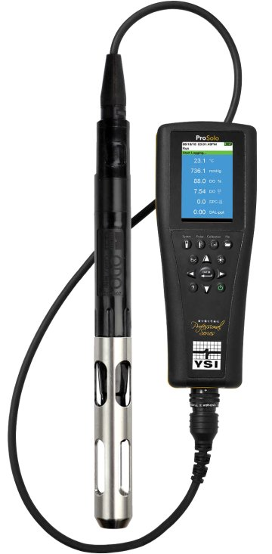

Data Collection
Collect dissolved oxygen, temperature, and conductivity measures
Measures taken every meter until 60ft.
Data will help us determine if higher oxygen, lower temperature layer remains in place all summer long

Slide 31
Next Steps
Collect data for at least 2 years
Train additional volunteers to use equipment and help with bimonthly data collection
Enter data into Surface Water Integrated Monitoring System (SWIMS)
Characterize oxythermal habitat conditions in Grindstone

Slide 32
Grindstone Lake Community
Donna Carlson

Slide 33
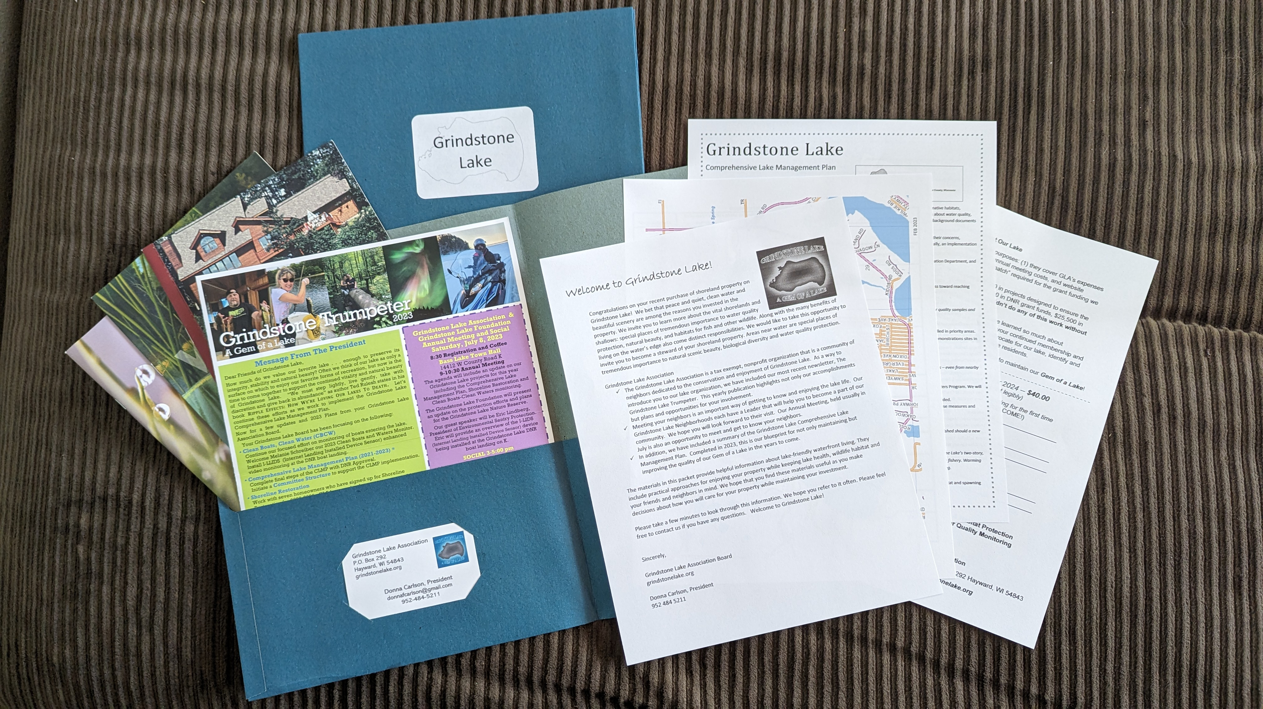
New Owner’s Packet
Welcome Letter
2023 Newsletter
Comprehensive Lake Management Plan Summary
Neighborhood Leaders
Grindstone Lake Map
Waterfront Living Pamphlets
2023 – 6 new Neighbors

Slide 34
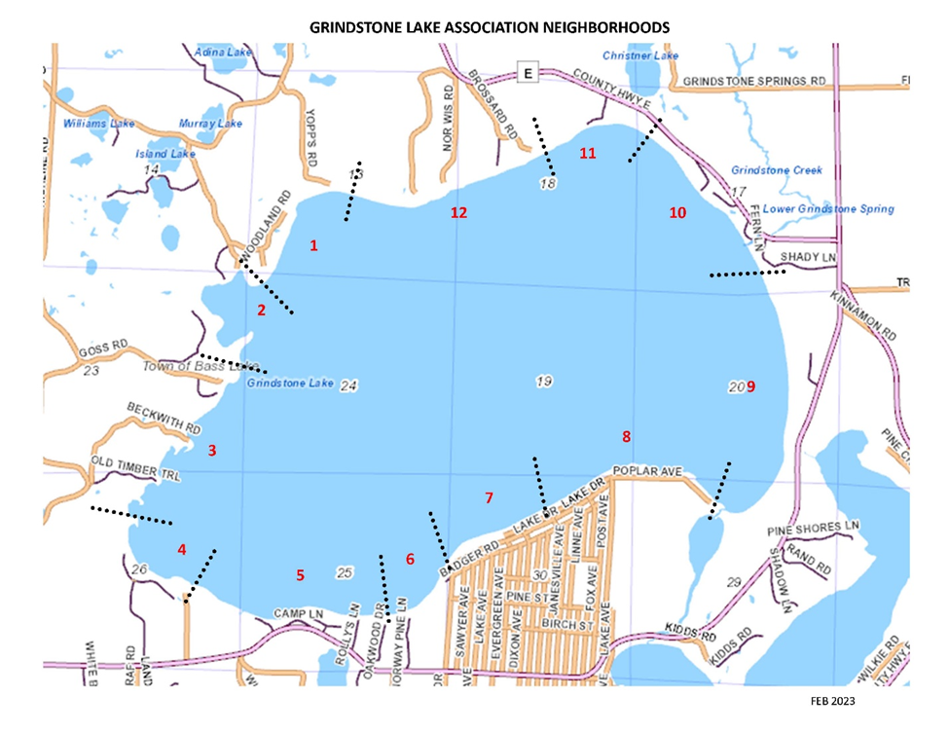
Neighborhoods
Neighborhood #10 -Leader needed
  Shady Ln, Fern Ln, Blue Spruce Ln, Sunset Ridge Ln
  County Hwy E 13877W thru 14083W

Slide 35
Water Level Update
Greg Klausen

Slide 36
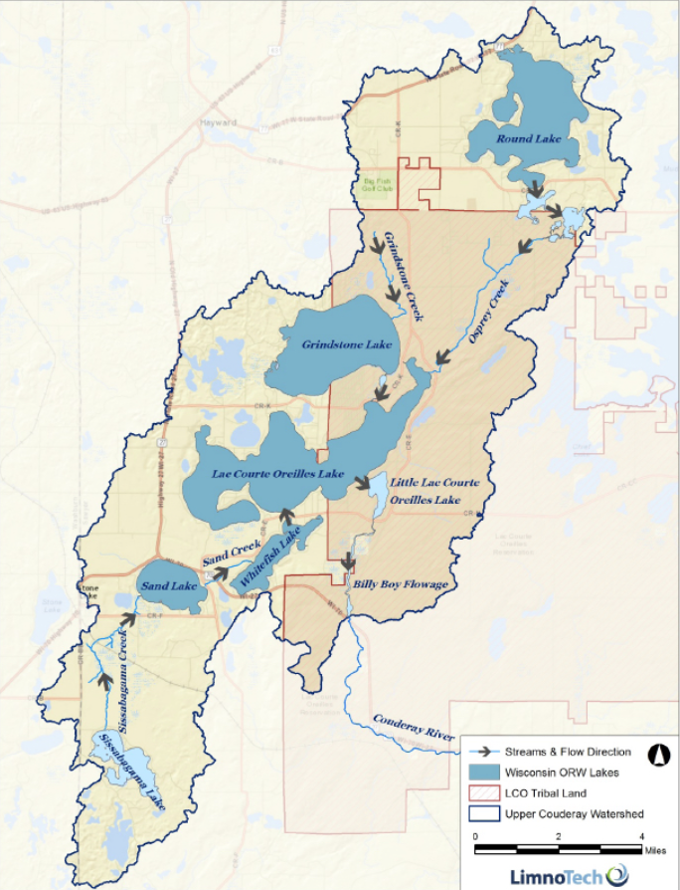
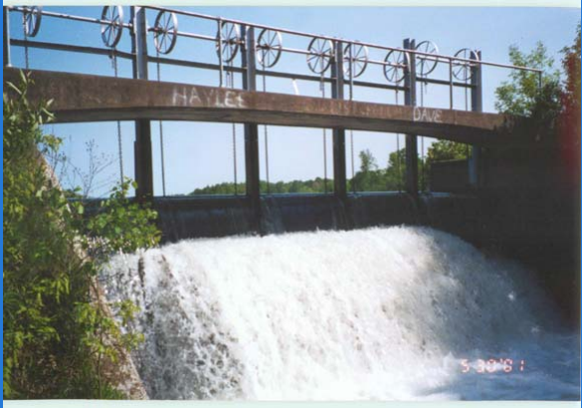
Emerging Issue
Water Level Update
Lake Levels
Billy Boy Dam
Billy Boy Dam

Slide 37
Historical Management
1935 - Grindstone and LCO lake residents request old logging dam be updated to maintain water levels
1942 - High water levels led to widening of 2 bridges upstream of dam to increase flow downstream
1954 - Public Service Commission of WI (PSC) required moveable gates to be installed
1955 - Under authority of Section 31.02, Statutes PSC established:
  Max level 97.3 feet
  Min level 96.8 feet
2021 - Sawyer Co. now managing according to PSC policy of 1955

Slide 38
Water Level Update
May 2023 - Proposal Letter to DNR to reinstate historical level
Sept 2023 - Legal rights determination letter to DNR
April 2024 - GLA joins effort, formal update to Cty & DNR
  78% concerned about high water level in 2022 survey
May-June 2024 - Pres. Whitefish Association multiple calls with DNR
June 2024 - Request to Sawyer Cty to add gauge at Cty Rd E
  Will not do unless DNR mandated
DNR response pending passing of three discussion groups
  One of which is the cranberry group

Slide 39
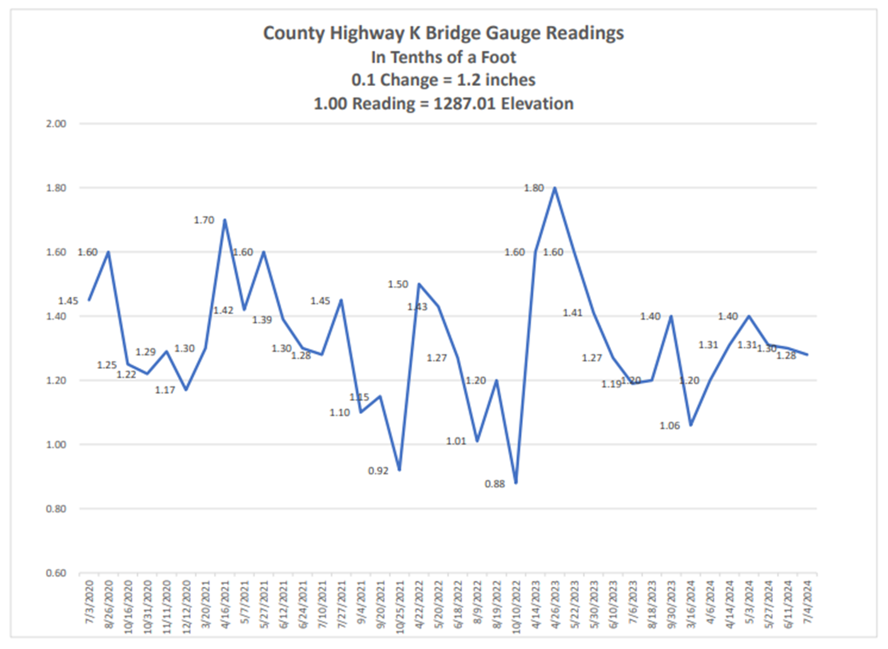
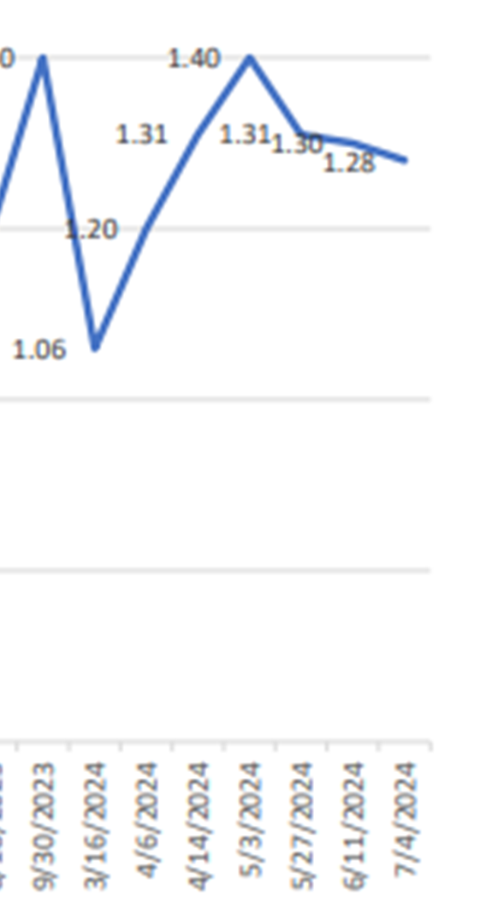
GLA
Monitoring
Informal
Low ‘24 start level
Impact of Rain
Impact of Gates opened in May
Currently 1.28 ft

Slide 40

GLA
Monitoring
Informal
Low ‘24 start level
Impact of Rain
Impact of Gates opened in May
Currently 1.28 ft

Slide 41
Grindstone Lake Association
Governance

Slide 42
Board of Directors (for Review and Approval for 2024-2025)
Officers
Donna Carlson – President
Michael (Mike) Warden – Treasurer
Cynthia (Cindy) Parker – Secretary
Board Members
Cheryl Contant – Membership, Grants
Greg Klausen – Clean Boats, Clean Water
Sean Humphreys – Shoreline Restoration
Karen Mumford – Fisheries & Habitat, Water Quality
TBD – Communications
TBD - Web & Social Media Management
TBD – Annual Meeting, Outreach & Social Activities

Slide 43
THANK YOU!!!
Dave Kieffer – GLA Board Member – Retiring
Dee Hobbie - Newsletter Design and Production
Jane and Randall Linton - Loon Monitoring
Neighborhood Leaders
New & Renewing GLA members & Donors
Business Contributors
The Boulevard
Timber Marine
The Log Cabin Store

Slide 44
Reminder
Grindstone Lake Social: 2:30-4:30 PM
The Boulevard – Cash Bar, Snacks
Grindstone Lake Gear: 2025?
Board Members & Volunteers Needed!!!

Slide 45
Guest Speaker
Max Wolter
Senior Fisheries Biologist, Bureau of Fisheries Management, Wisconsin Department of Natural Resources
Grindstone Lake Fishery: Status & health update

