Slide 1

Grindstone Lake Association
2025 Annual Meeting
July 5, 2025

Slide 2
Agenda
Grindstone Lake Association – Donna Carlson, President
Honor the Past, Plan for the Future - 35th Anniversary
GLA Governance
Financial Update – Mike Warden
Board of Directors
Guest speaker
Wisconsin’s Changing Fisheries – Colin Dassow, WI DNR
Protecting Grindstone Lake
CBCW – Greg Klausen
AIS in Little Grindstone – Cheryl Contant

Slide 3
Agenda
Grindstone Lake Foundation – Cindy Parker, President
GLF Governance
Financial Update – Mike Warden
Board of Directors
GLA Discussion/Questions

Slide 4
Honor the Past, Plan for the Future
Past Presidents
1990-2002 - Eric Nilsson
2002-2003 – Jim Garvey
2004-2006 – Bruce Miller
2006-2010 – Tom Gleason
2011-2012 – Steve Buss
2013-2015 – Dag Sohlberg
2016-2018 – Karen Mumford
2019-Present – Donna Carlson

Slide 5
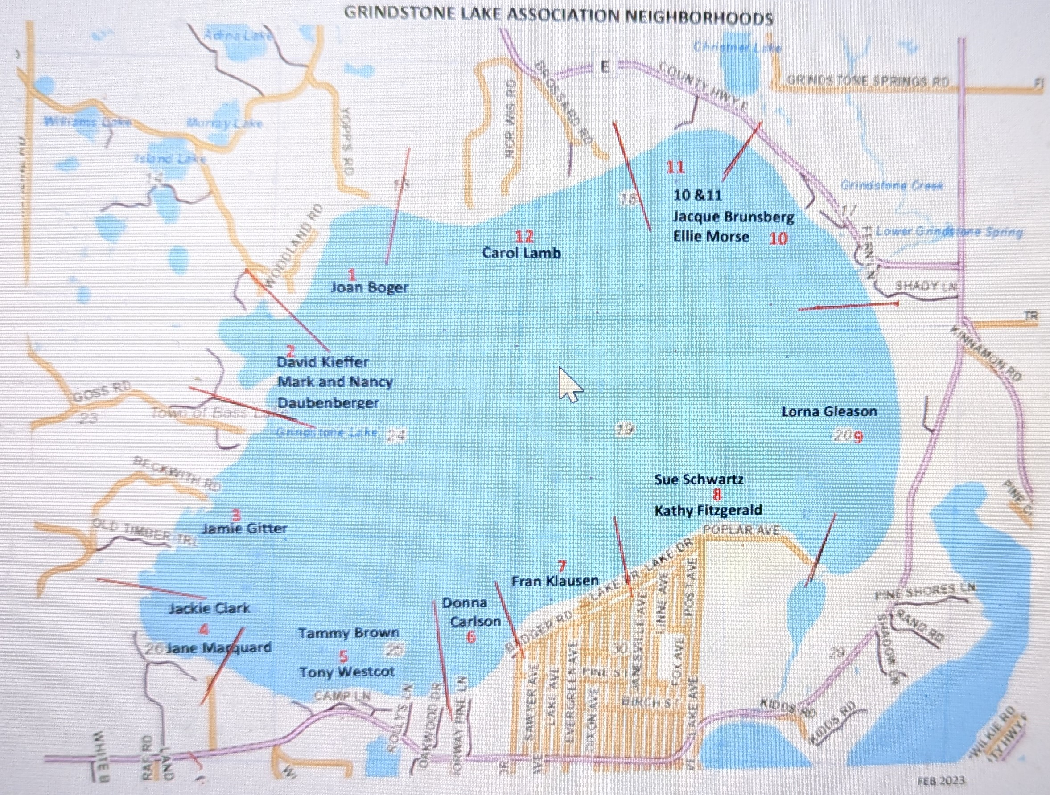
Honor the Past, Plan for the Future
Protecting Grindstone Lake
Neighborhoods for the Future

Slide 6
Financial Update
Mike Warden

Slide 7
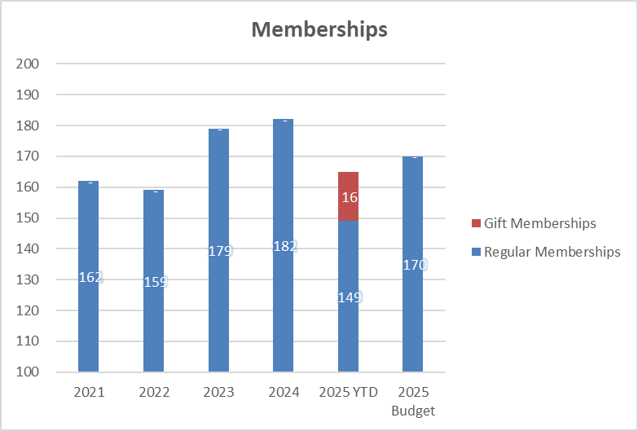
Financial Report

Slide 8
Financial Report

Slide 9
Financial Report

Slide 10
Grindstone Lake Association
Governance

Slide 11
Board of Directors
Review and Approval for 2025-2026
Officers
  Donna Carlson – President
  Michael (Mike) Warden – Treasurer
  Cynthia (Cindy) Parker – Secretary
Board Members
  Cheryl Contant – Membership, Grants
  Greg Klausen – Clean Boats, Clean Water
  Karen Mumford – Fisheries & Habitat, Water Quality
  Fran Klausen – Communications
  Ellie Morse – Neighborhood Leaders & Social Activities
  TBD - Shoreline Restoration
  TBD - Web & Social Media Management

Slide 12
THANK YOU!!!
Sean Humphreys – GLA Board Member – Retiring
Dee Hobbie - Newsletter Design and Production
Jane and Randall Linton - Loon Monitoring
Neighborhood Leaders
Lake & AIS Monitors
New & Renewing GLA members & Donors
Organizational Partners
Dan Tyrolt – LCO Conservation Dept
Ben Schleppenbach – WI DNR
Business Contributors
The Boulevard
Timber Marine

Slide 13
Reminder
Grindstone Lake Gear
Available to order & purchase today!
2026 Annual Meeting
Saturday, June 27, 2026
Saturday, July 11, 2026
Board Members & Volunteers Needed!!!
Check out the volunteer sheets being circulated

Slide 14
Wisconsin's Changing Fisheries
Colin Dassow, PHD
Fisheries Research Scientist
Wisconsin Dept. of Natural Resources

Slide 15
Protecting Grindstone Lake
Clean Boats, Clean Waters
Greg Klausen

Slide 16

Clean Boats, Clean Water 2024 Review
Grindstone has been participating in the CBCW program since 2004
CBCW monitoring is subsidized by a grant from the WI DNR
Inspectors are trained to inspect boats and educate boaters on invasive species at public landings statewide
Grant must be matched by a minimum # of volunteer hours
  Please register to help at: https://grindstonelake.org/contact-us/
 | Grindstone Lake | Sawyer County | Statewide
Boats Inspected | 1,096 (-16) | 11,072 (-547) | 144,765 (-12,329)
People Contacted | 2368 (+88) | 24,458 (-666) | 272,893 (-33,388)
Hours Spent | 318 (+4) | 5,892 (+94) | 80,962 (-2,321)
Notes:
This is 2024 data and the numerical change compared to 2023 data, pulled from DNR website for stats.
More people contacted per boat due to large groups around the holidays, especially the big promotional push around the 4th of July week.
Melanie talks with parents and kids, gave out cookies and treats to kids.

Slide 17
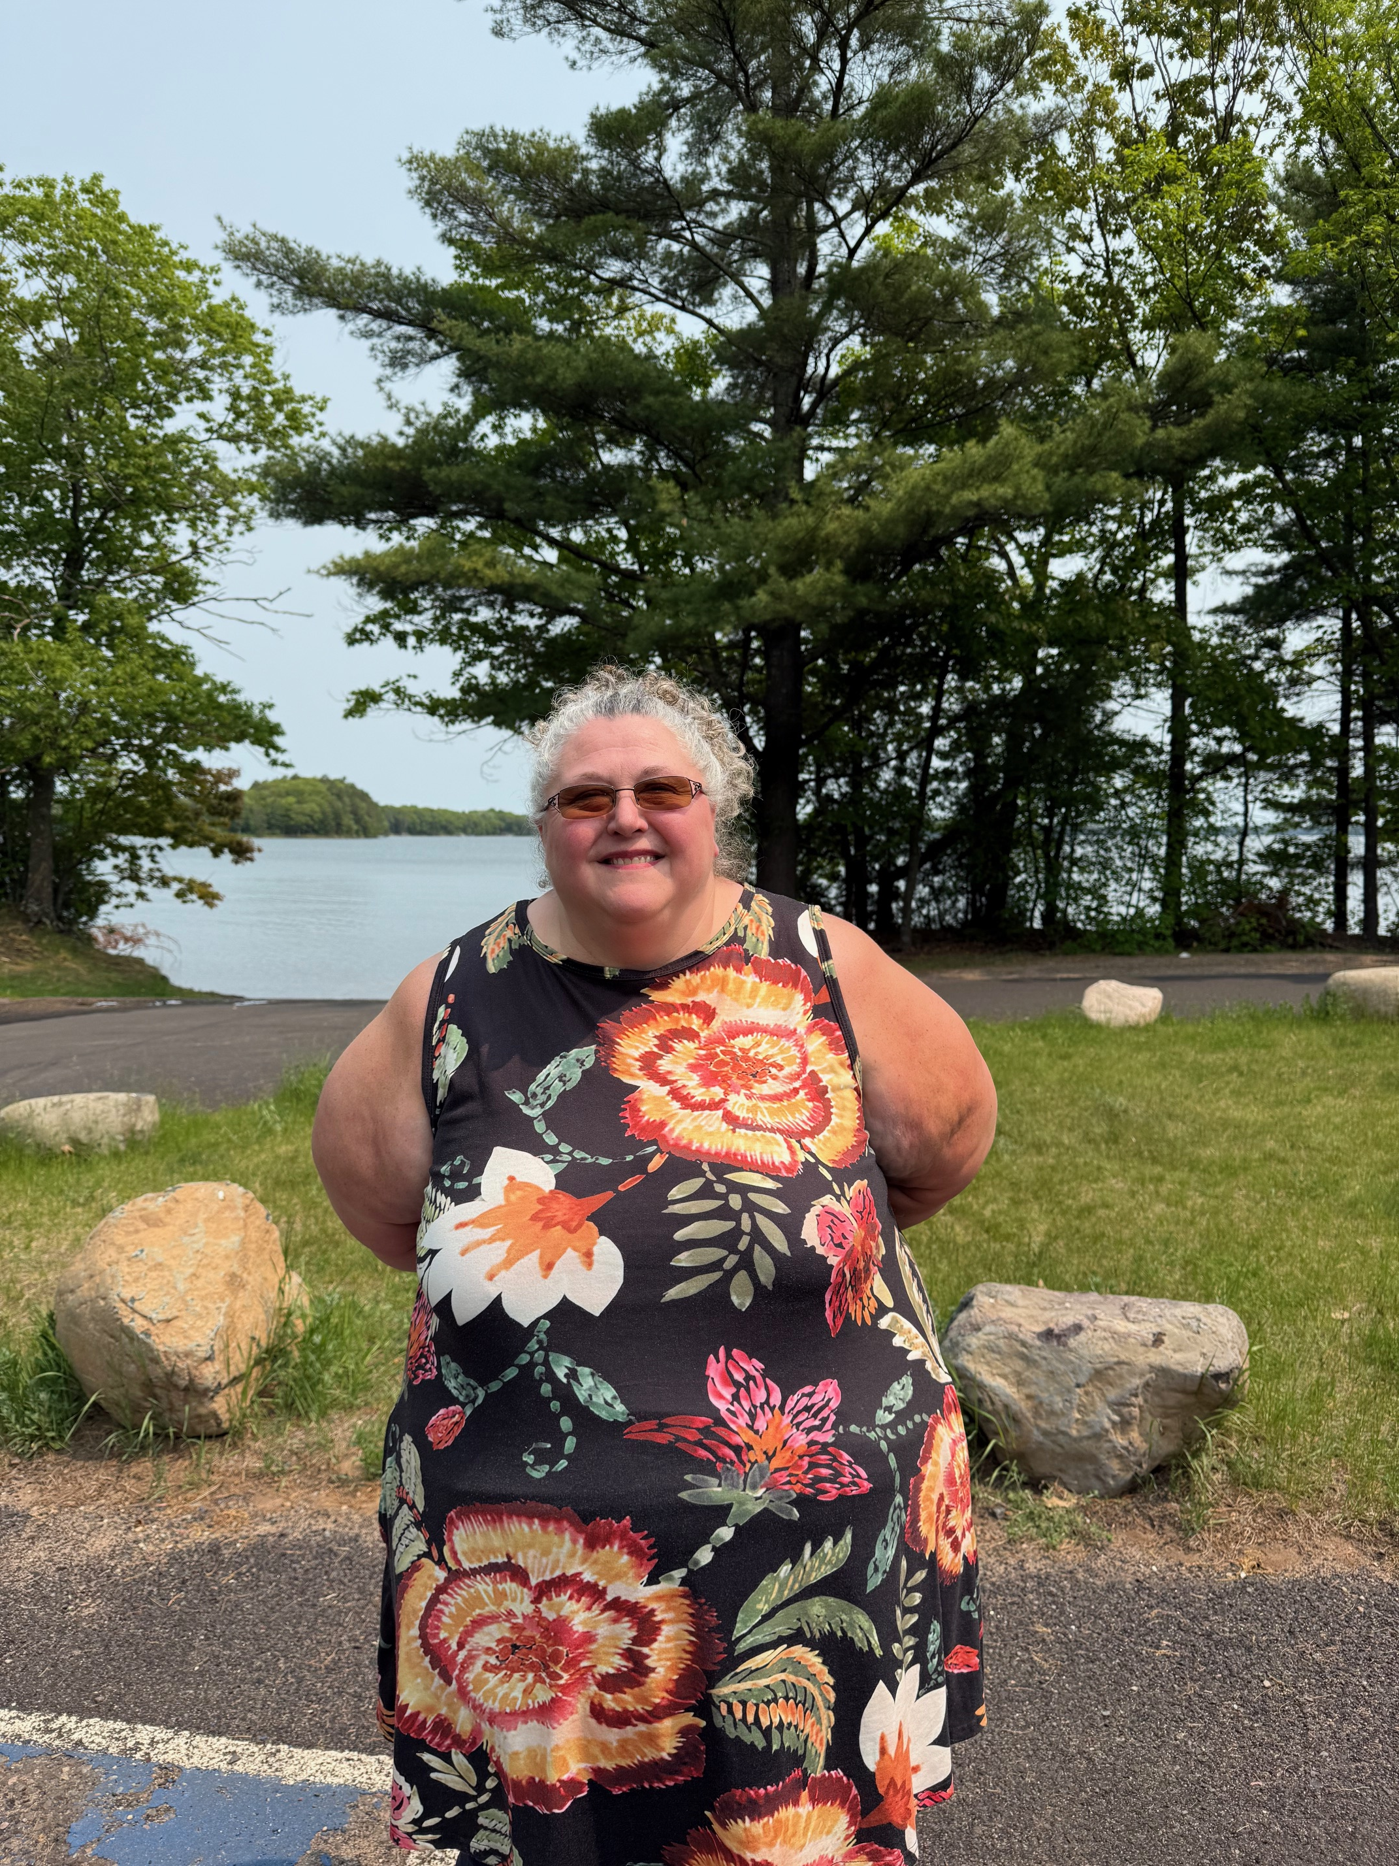
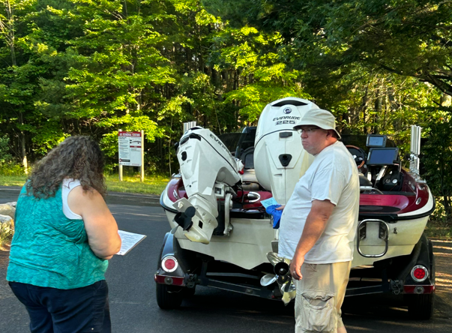
Clean Boats, Clean Water
Meet Melanie Schreiber, Grindstone’s 2025 CBCW Monitor
Resides in Turtle Lake, WI and grew up in the Spooner area
Has many years experience as a CBCW monitor – and it’s a family affair!
Possesses a passion for our great lakes and a drive to keep them clean
Stationed at Grindstone’s main public landing off Hwy K
Monitoring hours are 7:00am – 12:00 pm (Fri-Sun + Holidays)

Slide 18
Clean Boats, Clean Water 2024 Review
Eurasion Milfoyl Present
LCO
Chippewa Flowage
Round
Whitefish
Upper Eau Claire
139 boats
Notes:
During the inspection process we ask if your boat has been in another lake within the last 5 days.

Slide 19
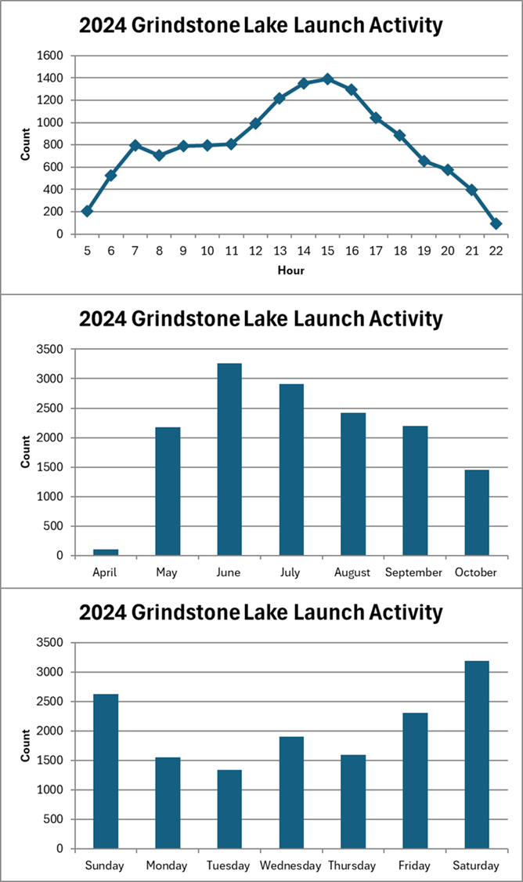
ILIDS
Grindstone 2nd year with ILIDS Video Capture
Additional monitoring over the In Person by Melanie

Slide 20
ILIDS Moving Forward
Grindstone 2nd year with ILIDS Video Capture
Starting to use Artificial Intelligence to improve the video accuracy and detect only vehicles with a boat
Need additional financial support to pay for video review, cost for 2024 was $2500
Video review volunteering is also a possibility if any interest

Slide 21
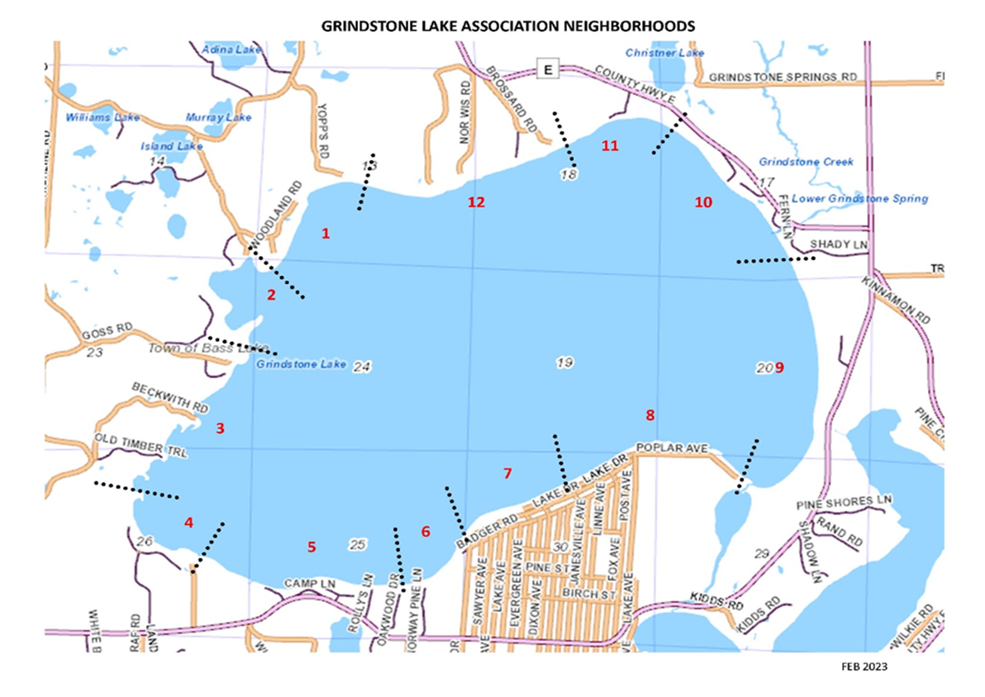

Grants and Volunteers working together
Citizens Lake Monitoring Activities
AIS ?
AIS ?
Oxythermal
Sechi Disk
GRANT MONITORING AND CONTROL
AIS ?
AIS ?
CBCW
ILIDS
AIS REMOVAL
Notes:
Interested in volunteering?? Need more volunteers for new AIS Lake Monitoring!

Slide 22
Protecting Grindstone Lake
Aquatic Invasive Species (AIS)
Cheryl Contatnt

Slide 23
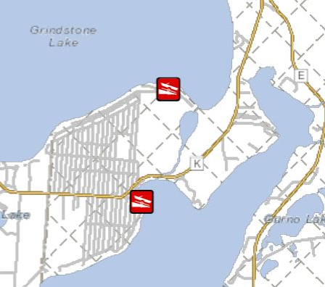
Little Grindstone Lake

Slide 24
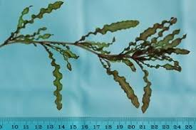
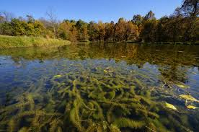
Little Grindstone Lake
Aquatic Invasive Species:
Curly Leaf Pondweed (2006); early season plant
Eurasian Water Milfoil (2023); coming from LCO

Slide 25
Little Grindstone Lake AIS
Applied for (Nov 2023) and received (March 2024) AIS Population Control Grant for $17,700 for 2024-25
AIS meander surveys to locate CLP and EWM (2 per year)
SCUBA divers hand pull CLP and EWM
2024: One-day dives in June and August
2025: Two-day dive in June and one-day dive in August

Slide 26
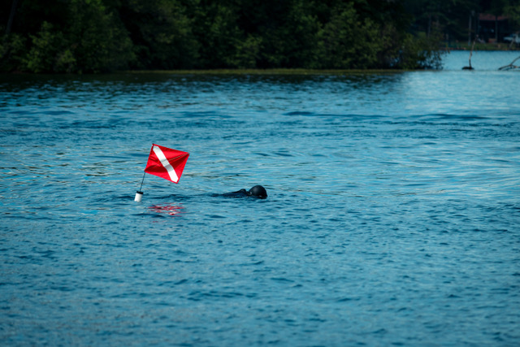
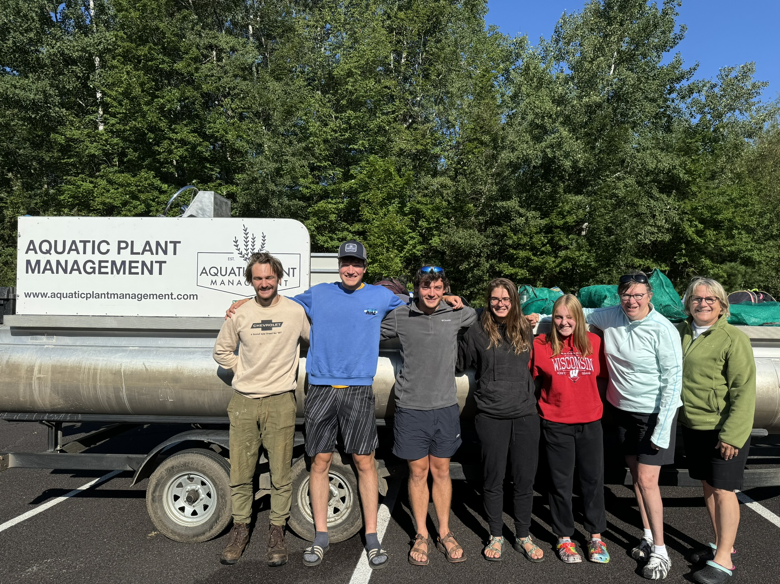
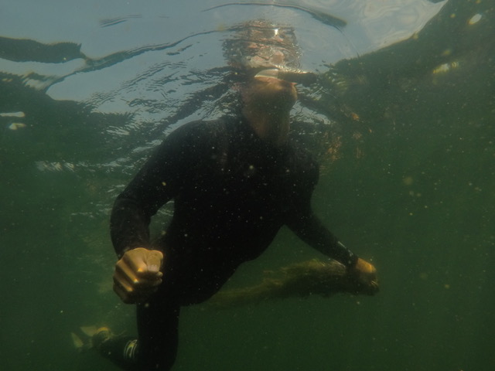
Little Grindstone Lake AIS
SCUBA divers hand pull plants trying to get the roots

Slide 27
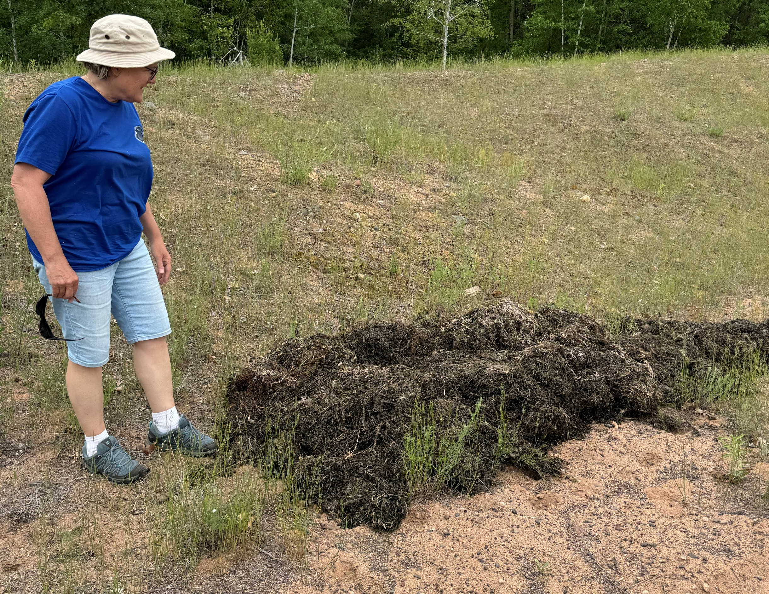
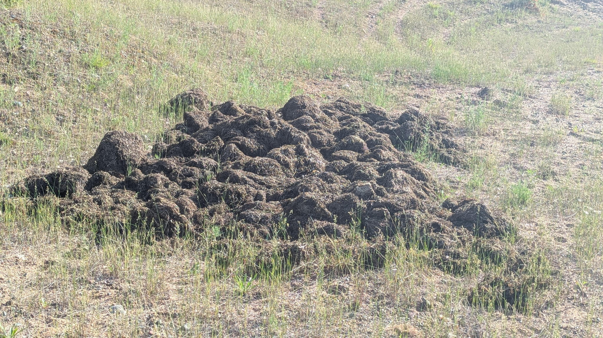
Little Grindstone Lake AIS
2024: Hand-pulled 66.5 cubic feet of AIS in 2 days
June 2025: Hand-pulled 91 cubic feet of AIS in 2 days!!!

Slide 28
Little Grindstone Lake AIS
According to the dive leader
…there are more invasive species in and around that area than was previously mapped…it would require quite a few more days to get everything. Continuing to stay aggressive on the EWM site is imperative to reduce the continued spread throughout the lake.

Slide 29
Little Grindstone Lake AIS
Plans for rest of 2025:
August: One dive for one-day (budgeted as part of grant)
NEED: At least 2 additional days (about $5,600)
Seeking additional DNR funds
Seeking additional donations
Reapply for grant for 2026-2028

Slide 30
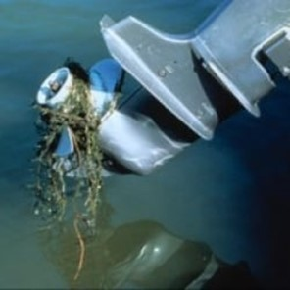
Little Grindstone Lake AIS
PLEASE HELP STOP THE SPREAD
When entering Little Grindstone Lake from LCO (under the Cty Rd K bridge), PLEASE reverse your engine and check propeller for “hitchhikers”
Keep the entirety of Little Grindstone channel and lake as a “SLOW, NO WAKE” Zone

Slide 31
Grindstone Lake Foundation
Cindy Parker

Slide 32
Grindstone Lake Association
Discussion/Questions?

Slide 33
Water Level Petition History
Proposal Letter to DNR (add 12” to return to pre 2021 levels) 5/2023
GLA joins effort, formal update to Cty & DNR 4/2024
Request to Sawyer Cty to add gauge at Cty Rd E 6/2024
  Will not do unless DNR mandated
Bass Lake Township Board rescinded letter supporting lower levels 6/2025
DNR response proposal to add 6” and new gauge location 6/2025
DNR Public Meeting and 30 day comment period TBD

Slide 34
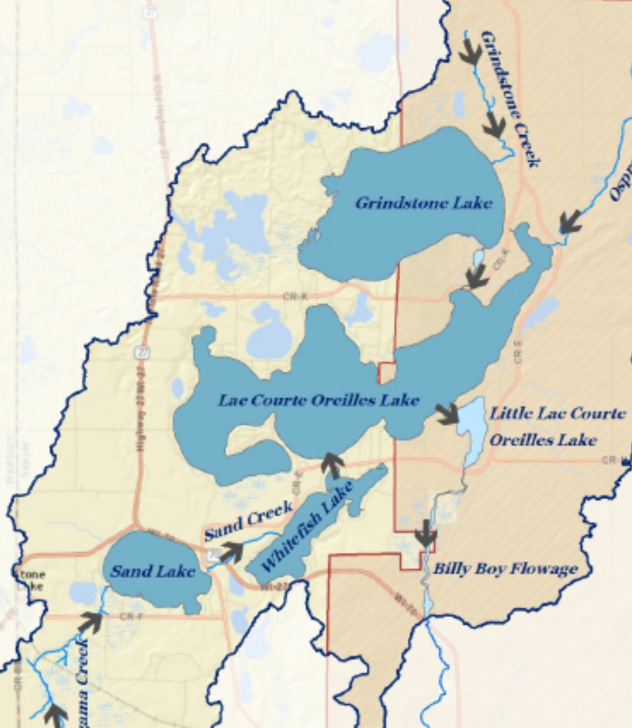
Lake Level Update
Bass Lake Township meeting in May
Bass Lake Township board sent rescind letter to DNR on 7/5/2025
Sawyer Cty Zoning and Conservation neutral
DNR Public Meeting TBD
Watershed flow map shows impact between lakes and creeks

Slide 35
Hwy K Bridge Gauge Readings
Informal
Low start level the last 2 yrs
Impact of Rain
Impact of gates opened in May each yr
1.0=1287 Elevation
0.1 change = 1.2”

