Slide 1
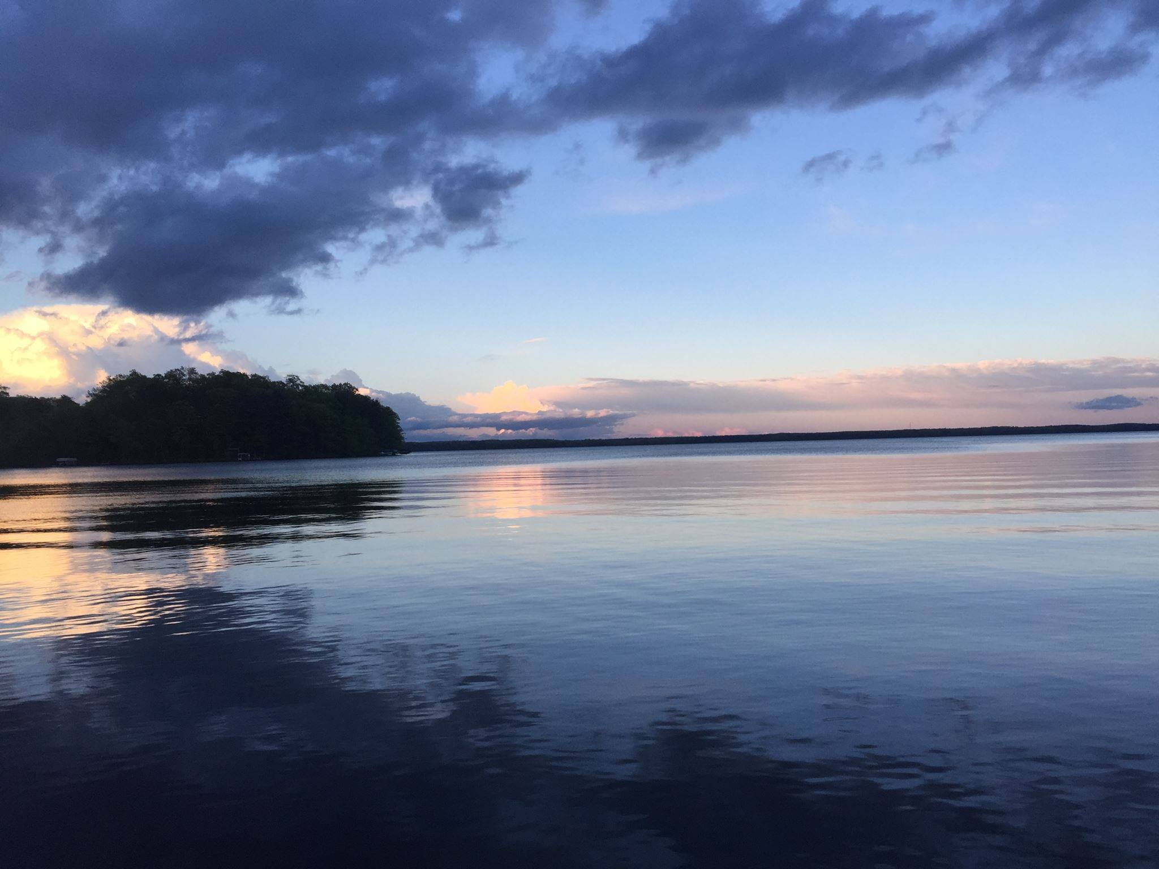


Slide 2

2025 Annual Meeting

Slide 3
Thank you for your continued financial support
Alvin Carlsen
Donna Carlson & Mike Warden
Cheryl Contant & Karen Mumford
Randy & Jane Lieble
Katheryn McCoid
Jenny Nilsson
Reed & Cynthia Parker

Slide 4
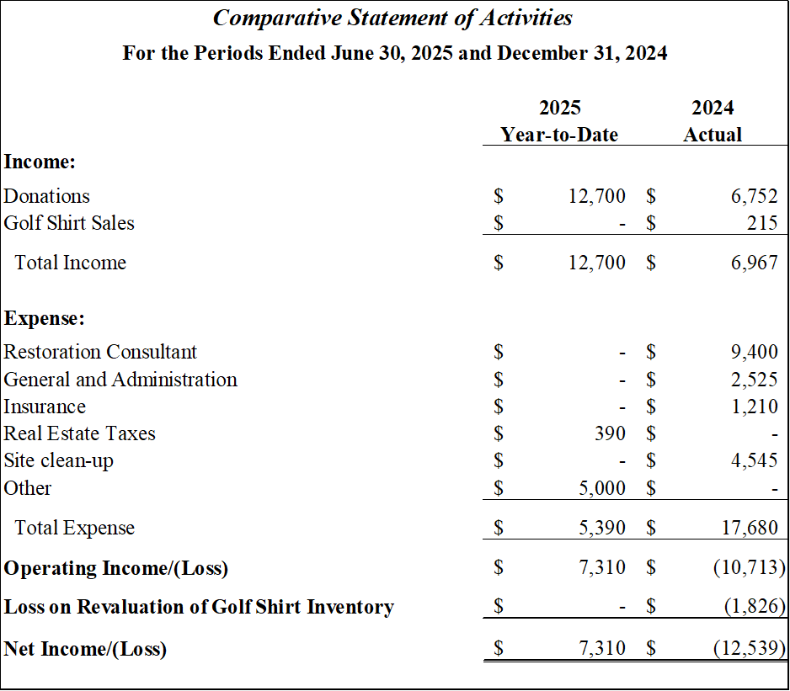

Slide 5
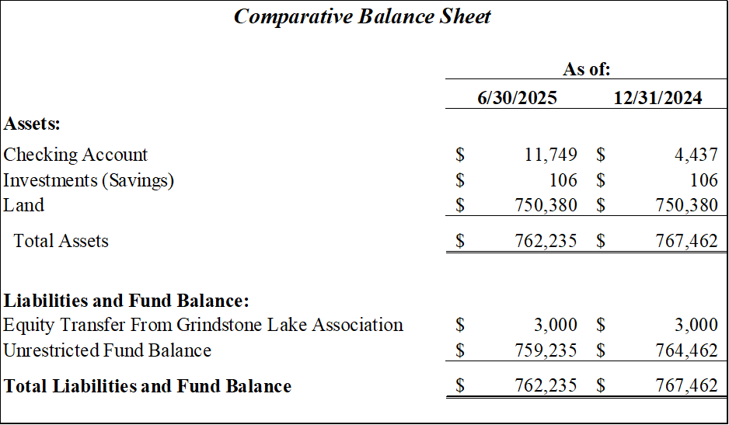

Slide 6


Slide 7
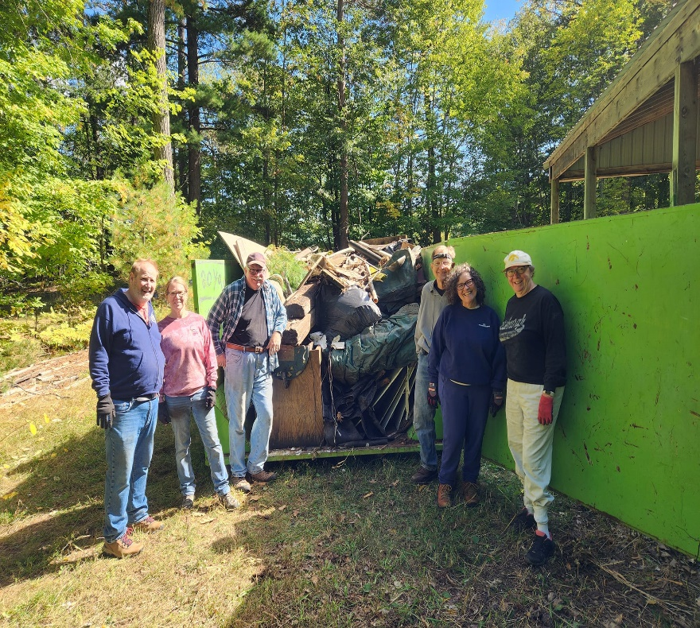
Clean up and Building Removal
In September of 2024, volunteers donated their time and funds for the cost of a dumpster and removed over 20 cubic yards of debris. Much of the debris was removed from the Shed, which is now ready to store a mower and other equipment to maintain the property.

Slide 8
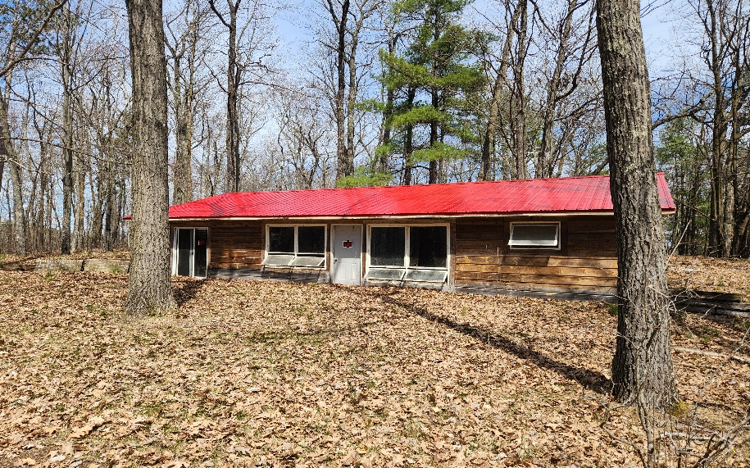
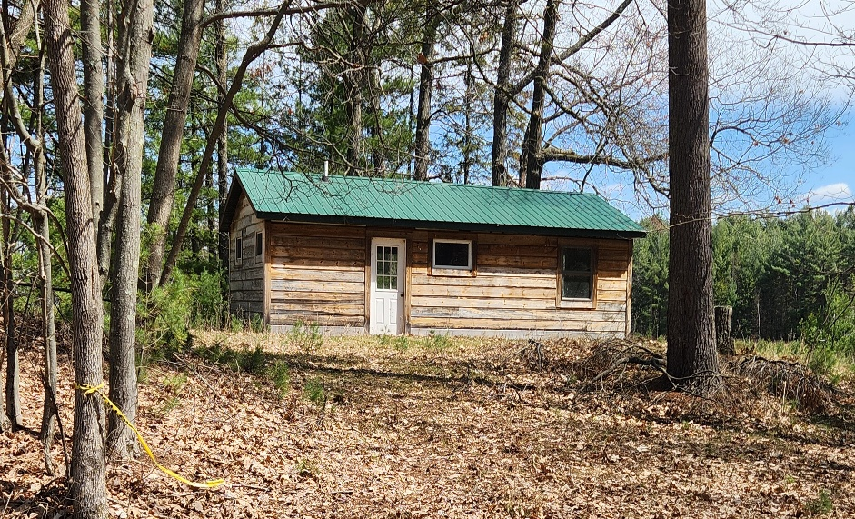
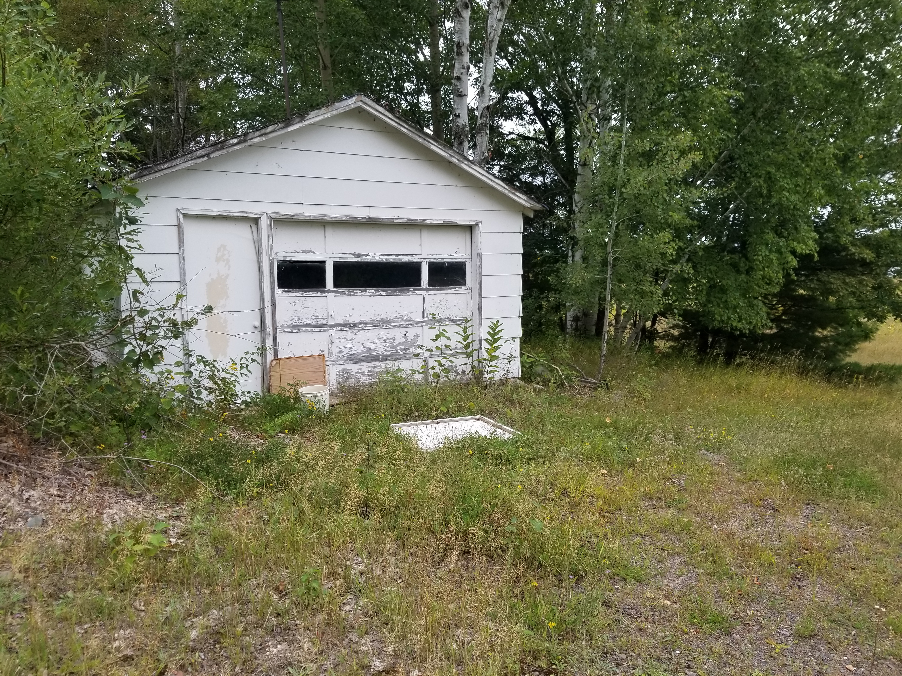
Clean up and Building Removal

Slide 9
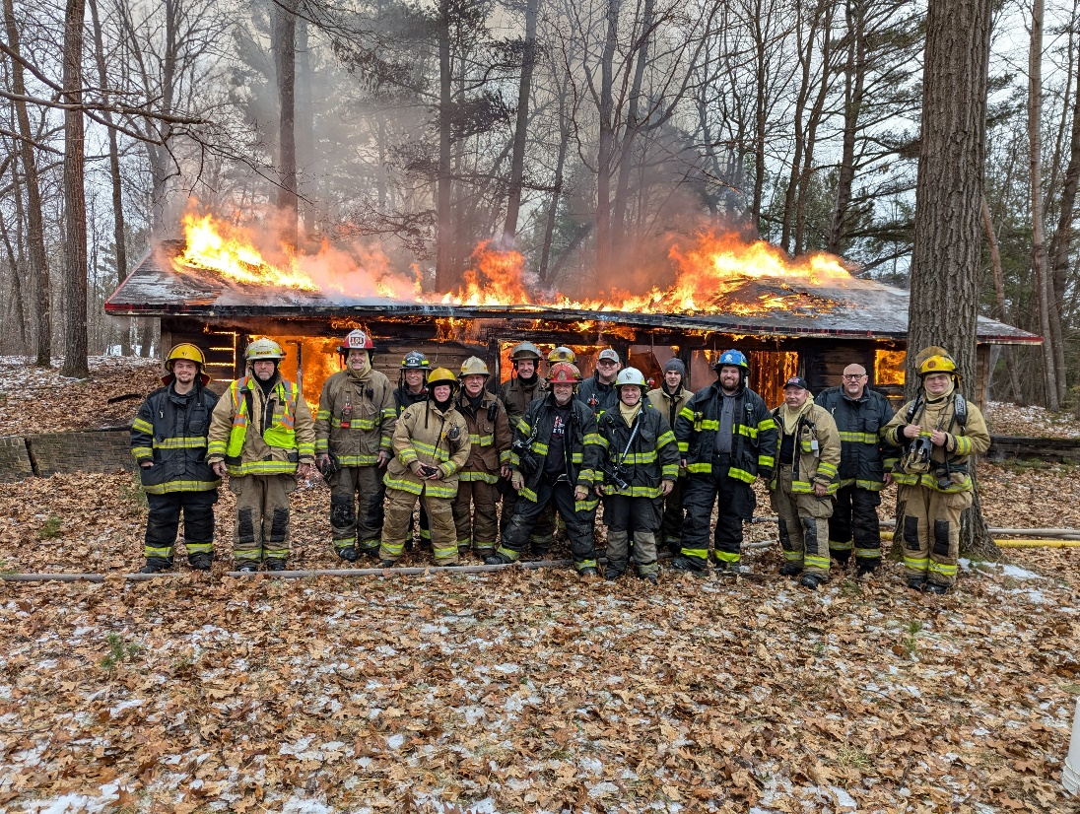
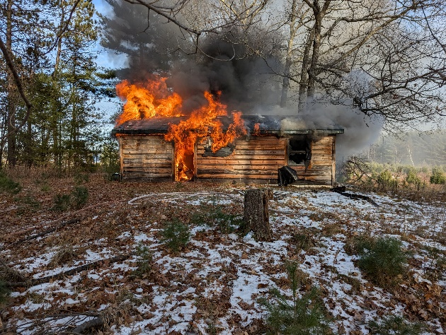
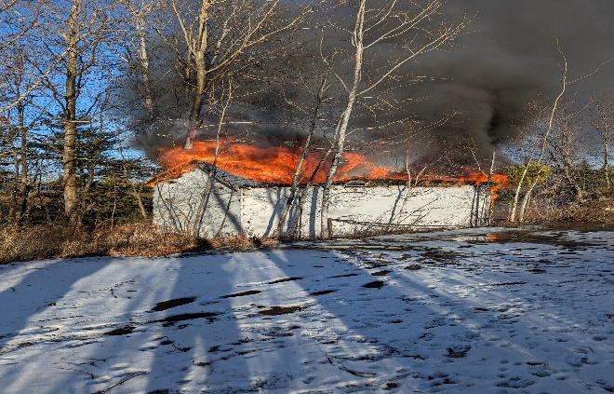
Clean up and Building Removal
The Bass Lake Township Fire Department along with the Fire Departments of Stone Lake, Hayward and Couderay held training exercises in December. During the training exercise, Firefighters burned down the two houses and an old wooden garage.

Slide 10
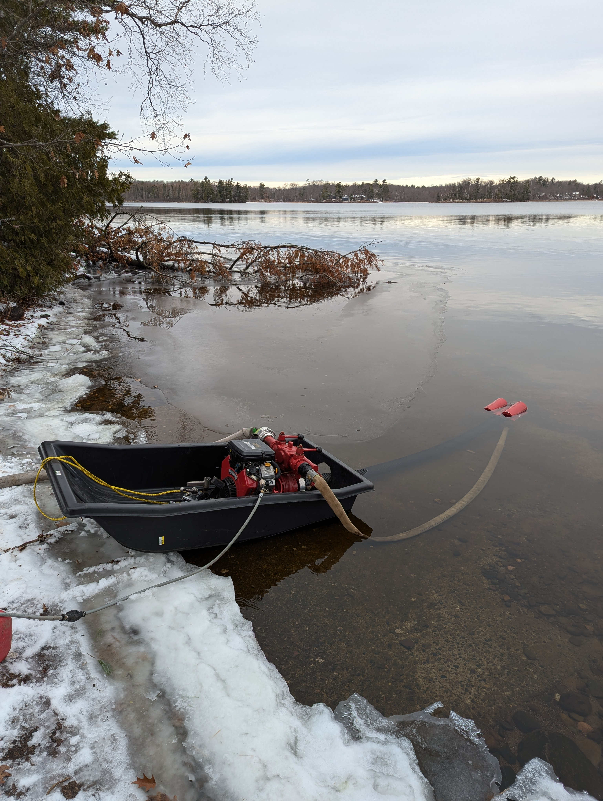
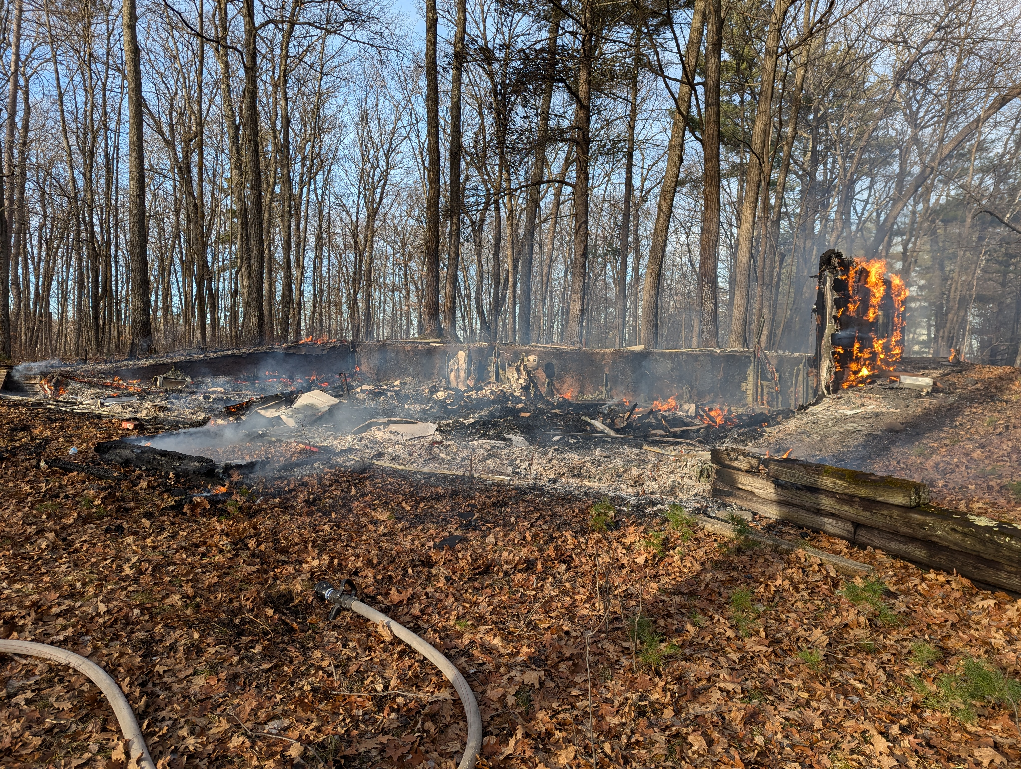

Slide 11
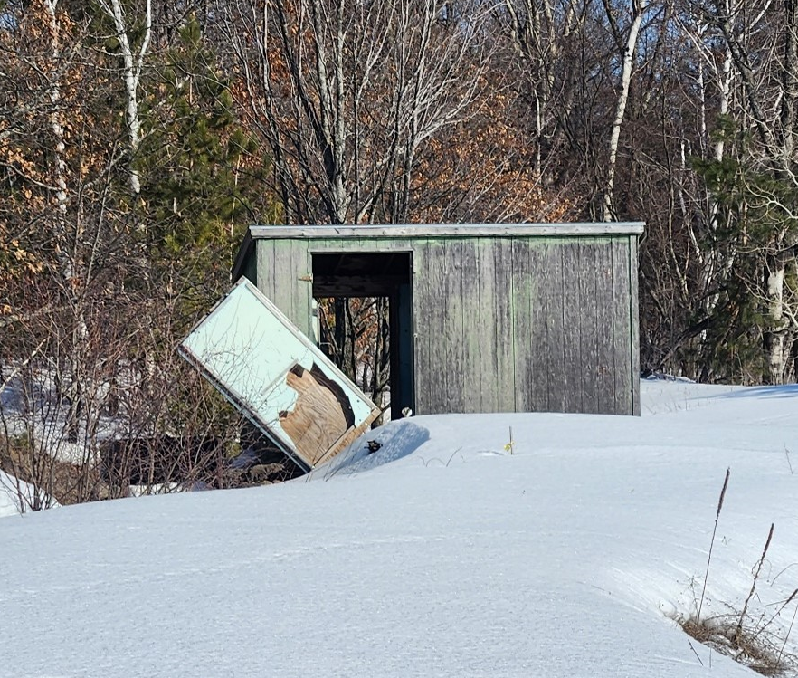
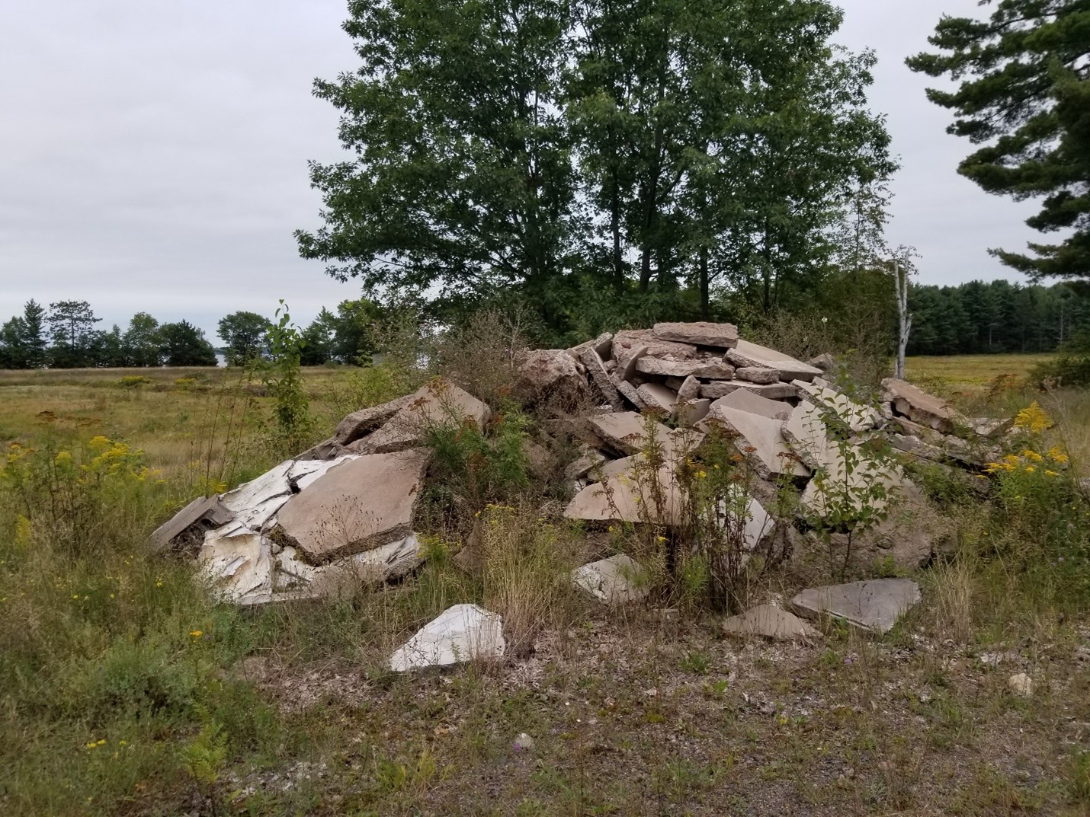
Clean up and Building Removal

Slide 12
PLANNING FOR THE FUTURE

Slide 13
Property Management Plan
The primary goals of the Grindstone Lake Foundation Property Management Plan are to provide:
water quality protection through restoration and protection of wetland, shoreland, and upland portions of the property, specifically the use of native/natural landscape management, including no manicured landscaping and no additions of impervious surfaces or structures;
passive low-impact public recreational experiences; and
educational experiences and demonstration sites that provide information about the importance of wetland, shoreline and nearshore habitats and land restoration.

Slide 14
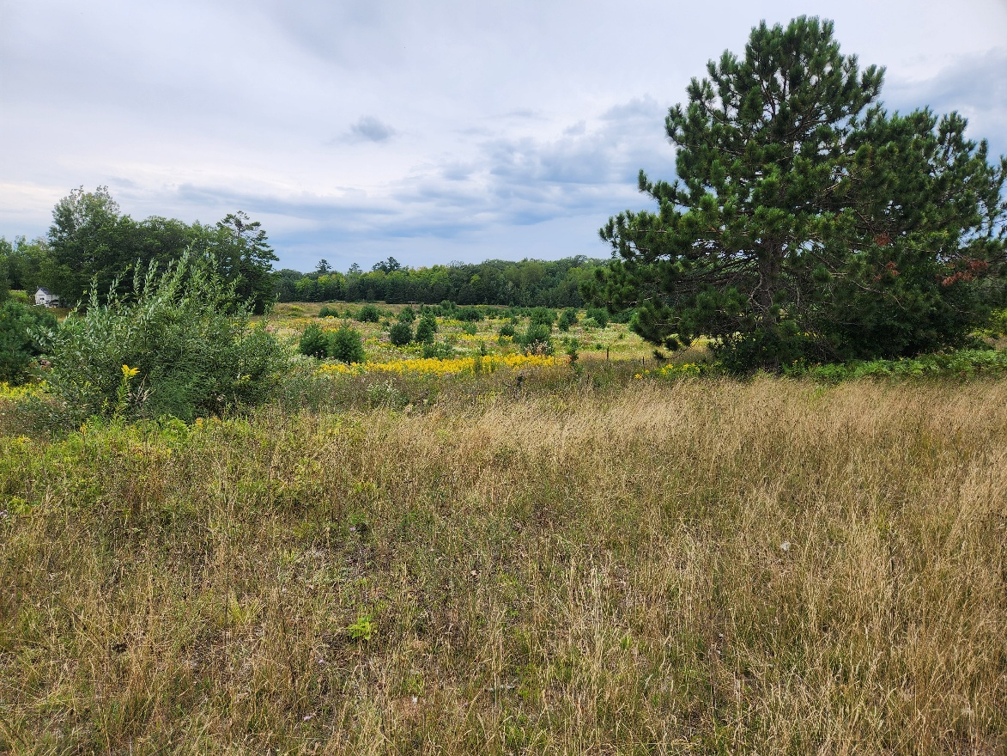
Wetland Restoration
We received a $30,000 grant from the WI DNR Wetland GP Surcharge Restoration Program to assist with preliminary restoration work

Slide 15
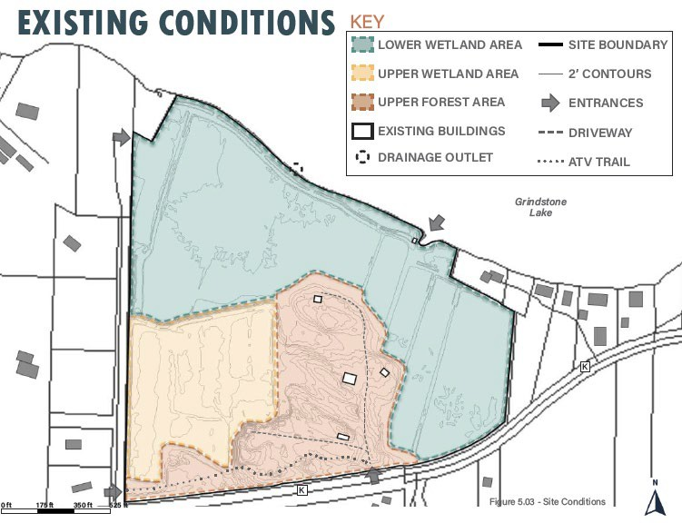


Slide 16
Grindstone Lake Comprehensive Lake Management Plan includes protection of the Watershed
The Foundation will assist in the protection of the Watershed through additional land acquisitions

Slide 17
WE NEED YOUR ASSISTANCE…
  Trail maintenance
  -donations of machinery (tractor mower, brush cutters, etc.)
  -mow the trails during the growing season
  -assist in cutting and handling downed trees

Slide 18
OPPORTUNITIES
Be a part of the vision
  Become a Board Member
Volunteer for one of our committees
  Trail maintenance
  Community Outreach
  Social Media
FOR OUR GEM OF A LAKE

Slide 19

BOARD OF DIRECTORS
Cynthia (Cindy) Parker – President
John (Jack)Minton – Vice President
Michael (Mike) Warden - Treasurer
I. Reed Parker - Secretary
Donna Carlson
Cheryl Contant
Karen Mumford
Anthony (Tony) Westcot

